Slide 1
Welcome!
Lowry Hill Neighborhood Association
Annual Meeting
May 25, 2022

Slide 2
Tonight’s Agenda
Opening Remarks by City Council Member Lisa Goodman
President Chas Scheiderer’s Yearly Update
Treasurer Toni D’Eramo’s Financial Report
Events with Events Chair Jackie Brown-Baylor
Remarks by Crime & Safety Chair Sue Westerman
Address by Park Board Commissioner Elizabeth Shaffer, District 4
Election of Board Members

Slide 3
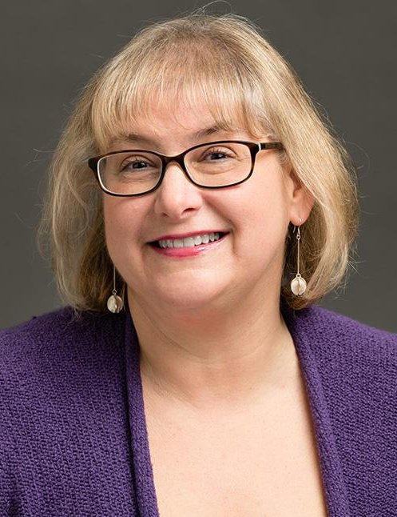
Lisa Goodman
Council Member City of Minneapolis Ward 7

Slide 4
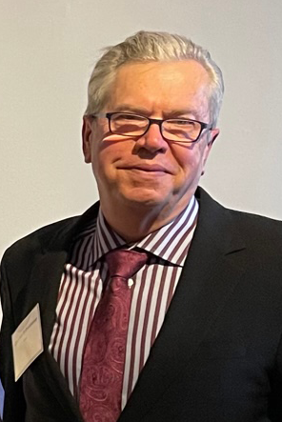
Chas Scheiderer
President
Lowry Hill Neighborhood Association

Slide 5
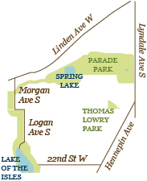
LHNA - Who We Are
One of 70 neighborhood associations in the city
one of the oldest, ca. 1970s
501(c)3 nonprofit
Work with City Neighborhood & Community Relations Staff
Operates within expectations of Neighborhoods 2020 plan

Slide 6
LHNA Board
Officers
Chas Scheiderer, President
Thomas Regnier, Vice-President and Historical Committee Chair
Toni D'Eramo, Treasurer and Communications & Outreach Chair
John Lillehei, MD, Secretary
Board Members
Jackie Brown-Baylor, Events Chair
Vickie Bennett
Fran Davis, Zoning Committee Chair
Tyler Ecklund-Kouba
Chad Harkin
Robert Hinck
George Montague
Anne Nelson
Sue Westerman, Crime and Safety Chair
Jennifer Wirick Breitinger

Slide 7
LHNA Monthly Meetings
Meet monthly from September to June
Open to all Lowry Hill Residents.
Meetings Include:
City Council Update by City Council Member Lisa Goodman
Crime and Safety Update with our 5th Precinct Inspector Katie Blackwell
Review of Committee work as needed
Forum for discussion of neighborhood initiatives

Slide 8
What Did We Do This Year?
Well, here are a few things
we’re especially proud of!

Slide 9
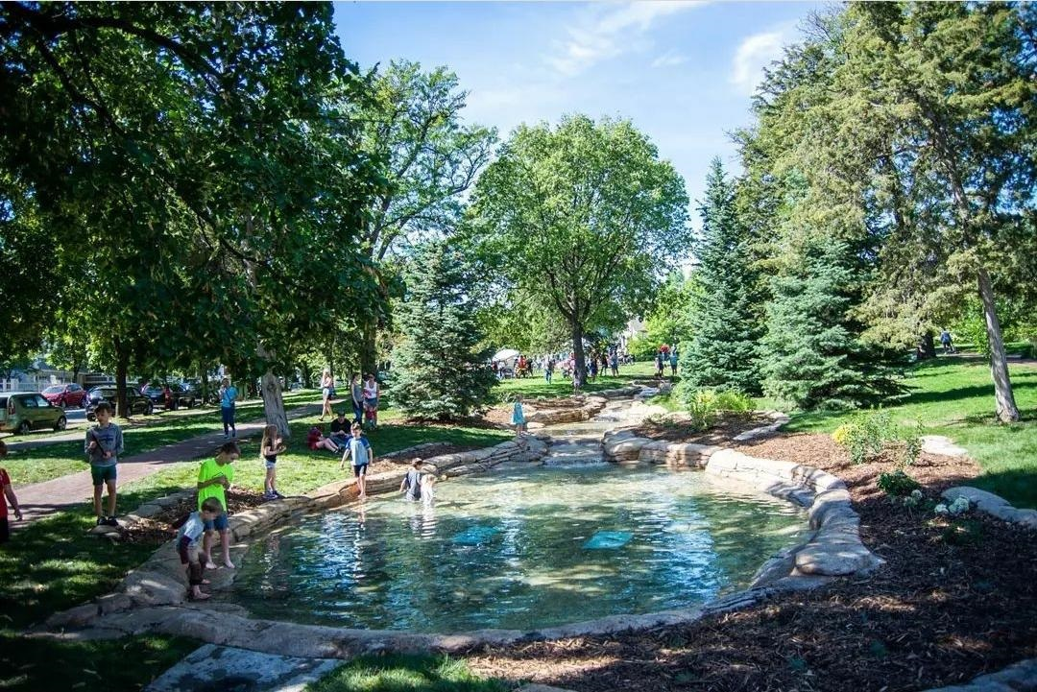
$341,980 for Thomas Lowry Park’s Seven Pools

Slide 10
$10,000 for North High School’s
Boys & Girls Track Team Equipment

Slide 11
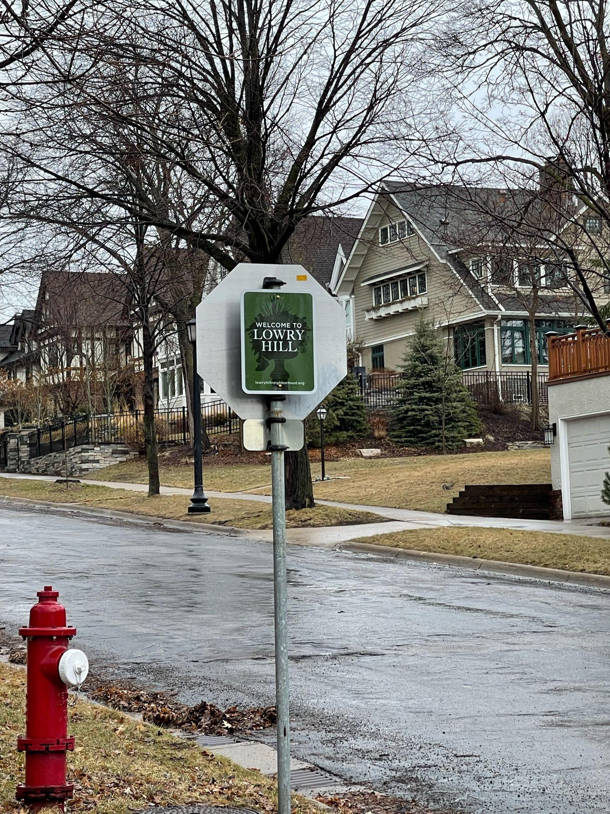
Designed & Implemented New Neighborhood Signage

Slide 12
$3,825 for Fremont Triangle Maintenance

Slide 13
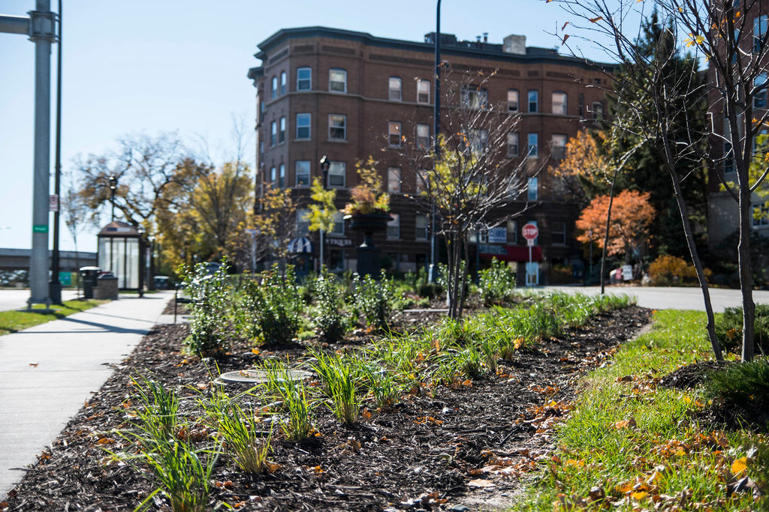
$83,424 for Douglas Median & Hennepin-Lyndale Crossroads

Slide 14
Other Past Projects
Loan to Propel support affordable housing initiatives
Bryant / Hennepin median clean up
Lowry Hill lampposts
Kenwood tennis court improvements

Slide 15
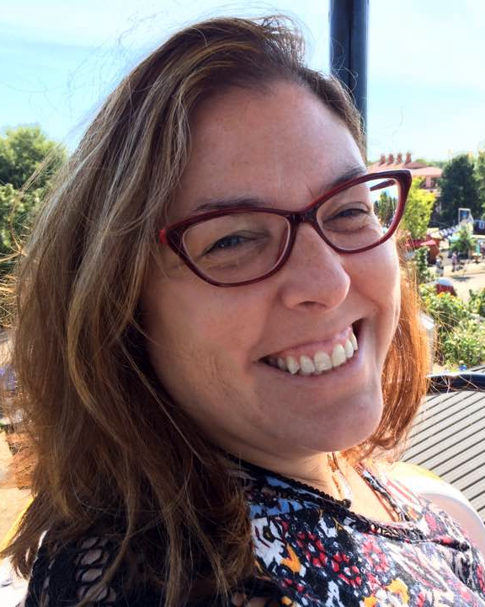
Treasurer’s Report
Toni D’Eramo Fiscal Year May 1, 2021 – April 30, 2022

Slide 16
LHNA Current Funding
City funds
Neighborhood Revitalization Program
Large projects like the ones just shown
Current iteration ended Dec 2021
Community Participation Program
Outreach and community events
Shifts to Network Neighborhood Fund this year
Donations
Support ongoing expenses after initial NRP investment
Cover expenses not reimbursed by CPP/NNF
Notes:
This report will be included in the Annual Meeting presentation that will be posted on the LHNA website

Slide 17
LHNA Fiscal 2021-2022
Total Revenue = $44,906
$39,624 city funding
$ 5,243 donations
$ 40 interest
Total Expenditures = $29,760
Events, outreach, communications, administrative costs
Large NRP expenses were in previous fiscal year
Total Liabilities = $10,000
Total Cash on Hand = $41,786

Slide 18
LHNA Future Funding
2022
$ 20,000 Network Neighborhood Fund
$ 8,400 Equitable Engagement Fund (need plan approval)
2023
$ 10,000 Network Neighborhood Fund
$ 9,118 Equitable Engagement Fund (need plan approval)
Additional Sources
Partnership Engagement Fund - with community based orgs
Collaboration and Shared Resources Fund - with other neighborhood orgs
Partnership Engagement Fund
Citywide Neighborhood Network Fund

Slide 19
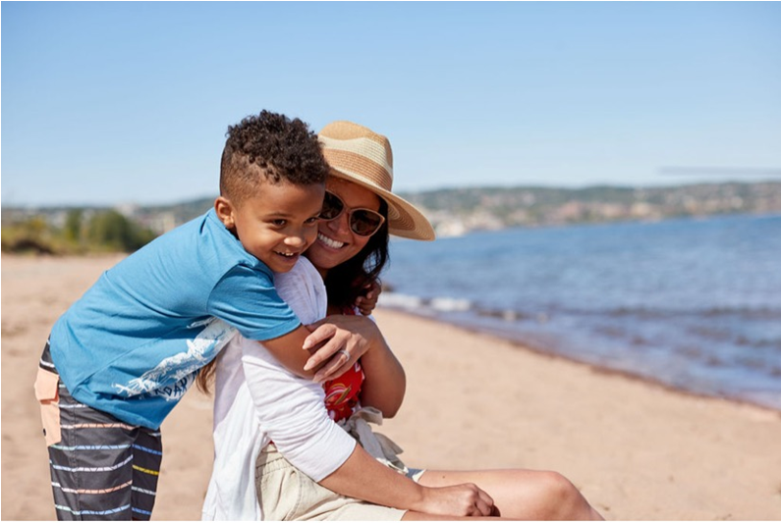
Events Committee
Jackie Brown-Baylor Events Chair

Slide 20
LHNA Events
This past year…
Virtual Meet your Principal with Mauri Friestleben, Steve White & Coach Skoglund from North High with Kenwood Neighborhood Association
Celebration of Seven Pools renovation with Friends of Thomas Lowry Park
October “Fall for Jazz” with Costume Judging in Thomas Lowry Park.

Slide 21
Upcoming LHNA Events
Annual Meeting May 25th
Ice Cream Social (July 16th or 17th)
The Historical Walking Tour collaboration with Preserve Minneapolis and Alliance
Gone Fishing August 21st @ Lake of the Isles
Neighborhood Super Sale September 10th 10-3pm will be advertised in Star Trib in collaboration with East Isles
Fall for Jazz in the Park (October 15th or 22nd, TBD)
Thrill Kenwood in collaboration with KNA (Oct 31st)
Annual Ice Skate Party in collaboration with East Isles (Jan 28th)

Slide 22
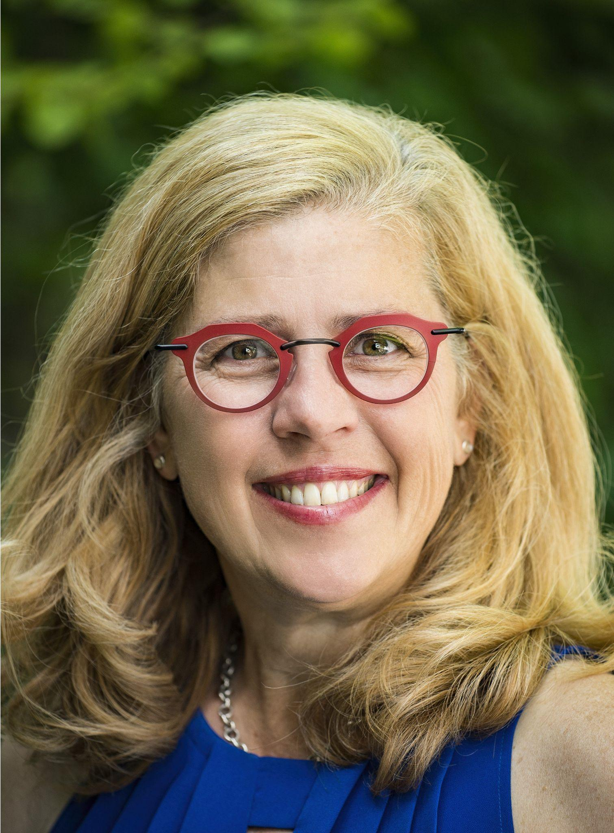
Events Committee
Sue Westerman Crime & Safety Chair

Slide 23
Crime & Safety Committee
Mission
The mission of the Crime and Safety Committee of the Lowry Hill Neighborhood Association (LHNA) is to be proactive with increasing safety/reducing crime and reactive in speed of communication of crime incidents (specifically violent crimes). Ultimately, we want to live in a community that we all feel safe.

Slide 24
Know Your Neighbor
Objective: Create a network is to increase accurate, timely communication specifically related to crimes within the neighborhood.... both on a block-by-block basis and across blocks
Established January 2021
Complements the city’s “block captain” program, 85% of the blocks are represented.
When notified of a violent crime, block leaders are emailed details of the incident and then they communicate with their neighbors. Note: We only communicate crimes if we receive information directly from someone present during the incident (not incidents from NextDoor,etc).
Block captains receive monthly crime statistics for Lowry Hill provided by the city.
Interested in being a block captain, let me know! Biggest gap is rental buildings.

Slide 25
Installation of Neighborhood Cameras
•Partner with MPD in installing cameras. LHNA pays for the installation ($7,000 per camera) and MPD covers all additional ongoing costs.
•2020 installed 4 cameras along Hennepin in conjunction with East Isles & Uptown.
•2022 planning to install 2 additional cameras: Irving and Franklin, Colfax & Douglas in Fall/Summer 2022

Slide 26
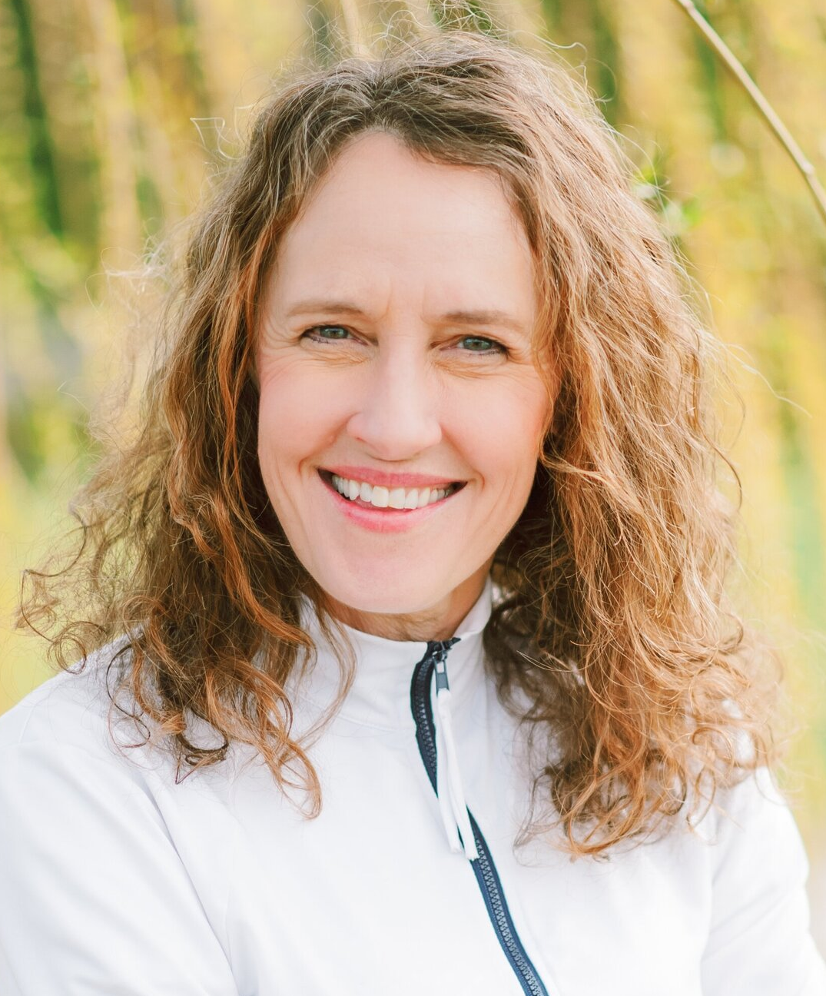
Elizabeth Shaffer
Commissioner Minneapolis Park Board District 4

Slide 27
LHNA Annual Meeting 2022 Elizabeth Shaffer Park Commissioner, District 4
eshaffer@minneapolisparks.org
m: 612-791-3701

Slide 28
My True North
Listen and understand all perspectives in decision-making
Is it consistent with our core MPRB mission?
Is it balanced, pragmatic and collaborative?
Will it serve the greater good?
Make the optimal decision
Effective communication of that decision

Slide 29
MPRB Board Policy Update

Slide 30
2022-2026 Strategic Directions
Act Boldly for our Climate Future
Act
Cultivate each Community’s Place in our Parks
Cultivate
Implement quality youth and intergenerational programming
Implement
Care for park assets to meet evolving needs and practices
Care
Steward our natural resources
Steward

Slide 31
MPRB Tree Planting 2022
$1,000,000 allocated
9,000 trees
72% native, 51 varieties

Slide 32
Repeal Resolution 2020-232
Restores park police ability to request MPD assistance at permitted park events (Medtronic Marathon, etc)
Restores ability for park police to respond to nonviolent calls for help from MPD as needed

Slide 33
Shaffer Policy Amendments to Date
Climate Action to Legislative Agenda - Passed
Pedestrian safety at Bde Maka Ska within Sailing School Contract Renewal - Passed
Speed of Multi-Modal Transportation within MPRB Scooter/Bike Contract - Passed
Reimbursement for Reduced Access at Cedar Lake South Beach - SWLRT Permit for Cedar Lake Road Closing - Failed

Slide 34
Lowry Hill Park Update

Slide 35
Cedar-Isles Master Planning
Highlights of Work to Date:
Water Quality Work Group
Board allocation of $50,000 to add Ecologist Consultant to work
Tremendous public engagement
Timeline
May/June 2022 – Preferred Design plan released
Summer 2022- more public feedback/CAC input/design edits
Fall 2022 – Draft Design with edits followed by a 30- day public comment time
Winter 2022/2023 – MPRB board approval

Slide 37
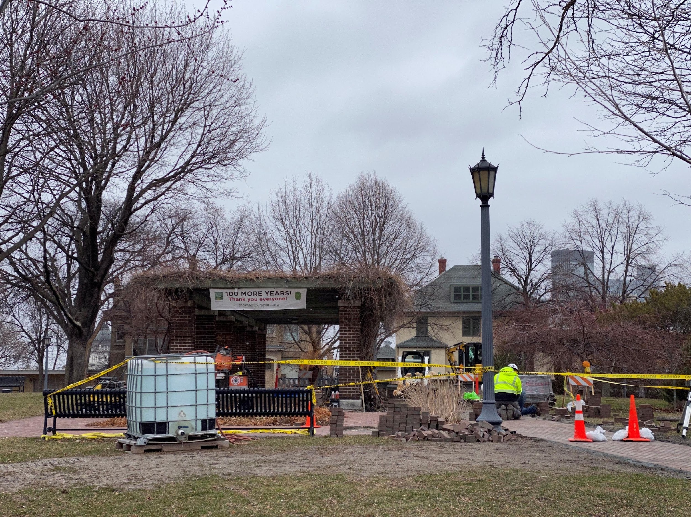
Thomas Lowry Park
Seven Pools restoration, fall 2021
New pavers for path complete, spring/summer 2022

Slide 38
eshaffer@minneapolisparks.org
m: 612-791-3701
Facebook: Elizabeth Shaffer for Parks

Slide 39
Elections & Terms
Board members serve 2-year terms
Maximum 3 consecutive terms
Special thanks to departing members:
Toni D’Eramo
Robert Hinck
Craig Wilson

Slide 40
Continuing board members
Will serve 2nd year of 2-year term
Jackie Brown-Baylor
Tyler Eckland-Kouba
Chad Harkin
Anne Nelson
Thomas Regnier

Slide 41
Proposed Slate for New Term
Candidates for election
Nate Morrow
William Goodnow
David Bjork
Vickie Bennett*
Jennifer Breitinger*
Fran Davis*
John Lillehei*
George Montague *
Chas Scheiderer*
Sue Westerman*
*returning

Slide 42
A few things before adjourning…

Slide 43
LHNA Future Funding
Should funding be increased? NRP reinstated?
Let the city know.
Neighborhood & Community Relations (NCR) - they submit a budget to Mayor Frey.
Mayor Frey - he can include more in the 2023 budget he submits to Council in August.
Lisa Goodman - ask council to look at funding the City provides to neighborhood groups.
Contact info on lowryhillneighborhood.org
Home page > Resources > City Government

Slide 44
Want to Get Involved?
Talk to a Board member tonight
Join a committee
Come to meetings:
1st Tuesdays, monthly September-June
7PM at Kenwood Rec Center or Zoom
Sign up for email news at
lowryhillneighborhood.org

Slide 45
LHNA always accepts your tax-deductible contributions
We value and welcome everyone in our community!
Thanks for your interest
Thanks for your participation
Thanks for your continued financial support
-And-
THANK YOU for your presence here tonight!
LHNA. P.O. Box 3978, Minneapolis, MN 55403
Or visit lowryhillneighborhood.org

Slide 46
Thank You! and please… Remember to Leave a Light On!

