Slide 1

2021 Annual Meeting
May 20, 2021

Slide 2
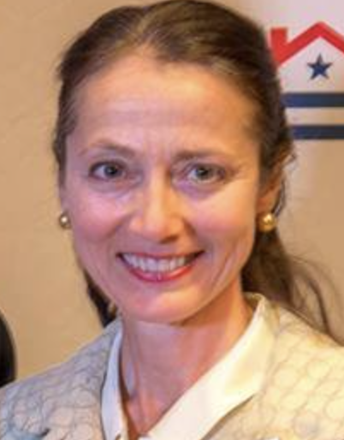
Welcome!
Jennifer Breitinger
LHNA Board President

Slide 3
Tonight’s Agenda
Welcome – Jennifer Breitinger, LHNA President
Guest Speakers
  Lisa Goodman – City of Minneapolis Council Member
  Marion Greene - Hennepin County Commissioner and Commission Chair
  Katie Blackwell – City of Minneapolis 5th Precinct Police Inspector
  Rebecca Hughes – City of Minneapolis Hennepin Reconstruction Project Lead + JoNette Kuhnau Project Consultant, Kimley-Horn
  Elizabeth Schaffer – President Friends of Thomas Lowry Park
About LHNA – Jennifer Breitinger
Treasurer Report – Toni D’Eramo
Election of Board Members – Janet Hallaway

Slide 4
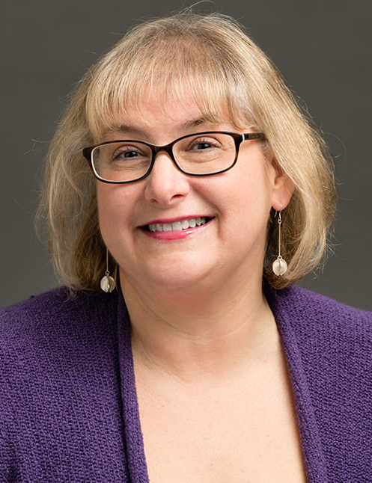
  Lisa Goodman
  City of Minneapolis
  Ward 7 Council Member

Slide 5
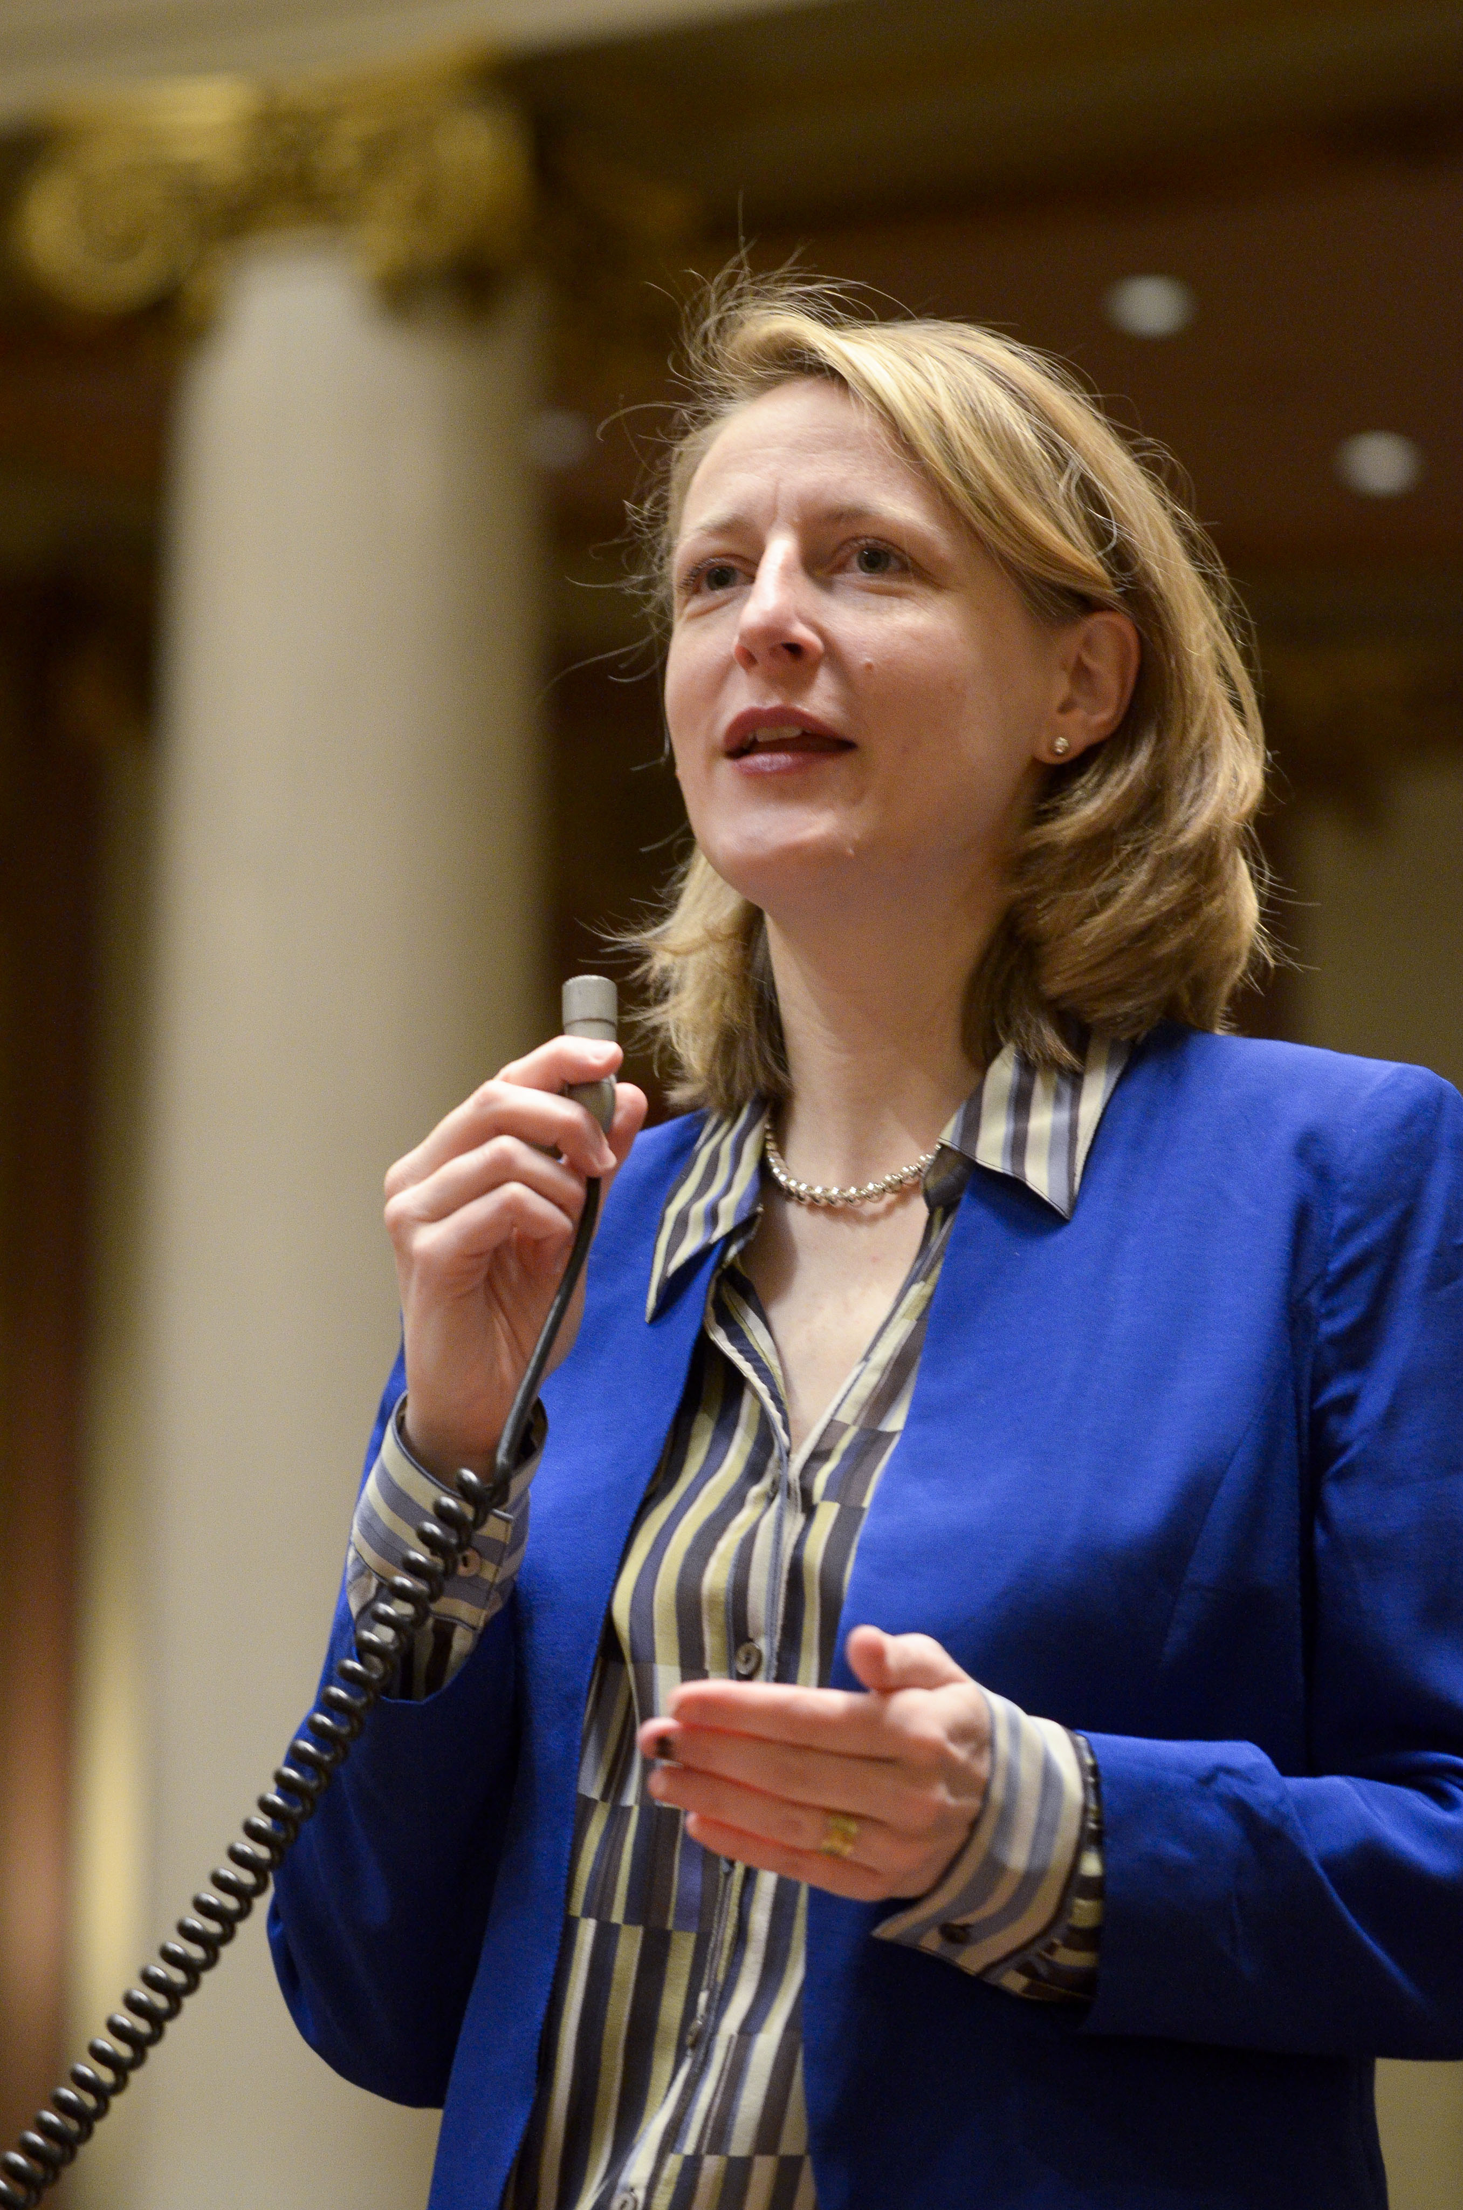
  Marion Greene
  Hennepin County
  District 3 Commissioner + Board Chair

Slide 6
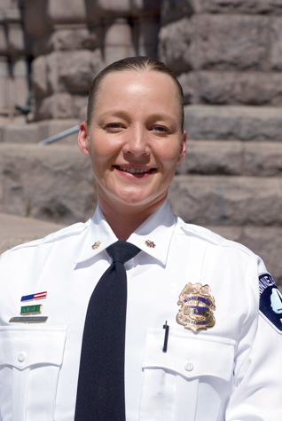
  Katie Blackwell
  City of Minneapolis
  5th Precinct Police Inspector

Slide 7
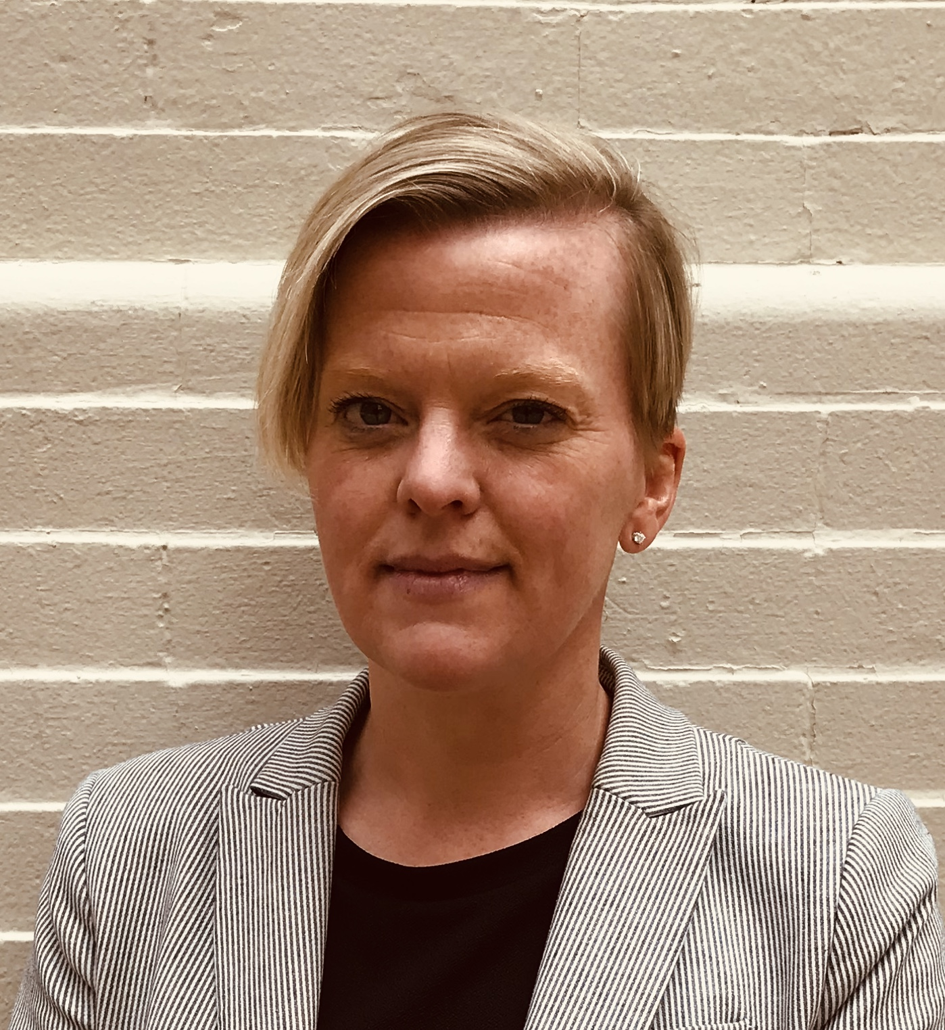
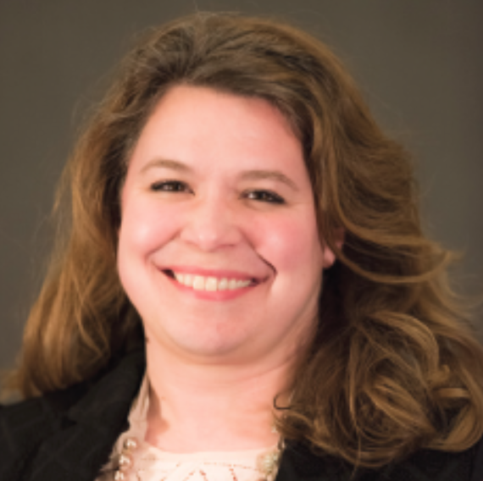
  Rebecca Hughes
  City of Minneapolis
  Hennepin Reconstruction Project Lead
  +
  JoNette Kuhnau
  Kimley-Horn
  Project Consultant, Traffic Engineer

Slide 8
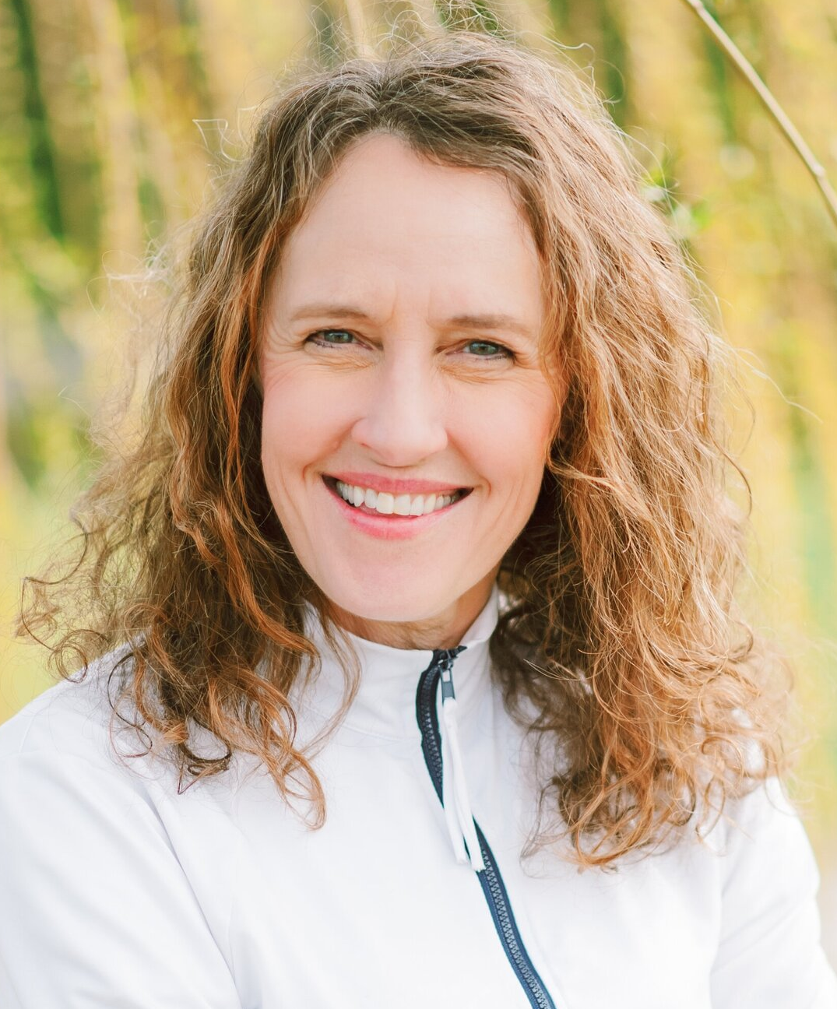
  Elizabeth Schaffer
  Friends of Thomas Lowry Park
  President

Slide 9
About LHNA
Jennifer Breitinger
LHNA Board President

Slide 10
Who is LHNA?
Board of Directors
  15 members
  All volunteers
  Elected by residents

Slide 11
Current Board
Executive Committee
Jennifer Breitinger, President
Robert Hinck, Vice President
Toni D’Eramo, Treasurer
Chas Scheiderer, Secretary
Board Members
Justin Baylor
Vicki Bennett
Kathleen Bottini
Fran Davis
Janet Hallaway
John Lillihei
George Montague
Thomas Regnier
Sue Westerman
Craig Wilson

Slide 12
What is LHNA?
Neighborhood organization
  ”Lowry Hill Neighborhood Association” 501(c)3 nonprofit
  Dedicated to addressing issues affecting Lowry Hill residents and businesses

Slide 13
Why LHNA?
Develops,
Encourages
and Promotes…
Programs, activities, and actions directed to the preservation, maintenance, improvement
and beautification of Lowry Hill.

Slide 14
Why LHNA?
The City’s official Community Participation Organization representing the Lowry Hill neighborhood:
3,834 people
  11% < 17 years old
  75% 18-64 years old
  14% 25-34 years old
2,323 housing units
55% renters / 45% owners
MN Compass 2017
https://www.mncompass.org/profiles/neighborhoods/minneapolis/lowry-hill
Notes:
4,000 people
Approx 2,000 are 25-44 years old
Approx 1,500 are 45-64 years old
Approx 500 are 65+ years old
70% renters
30% homeowner occupancy

Slide 15
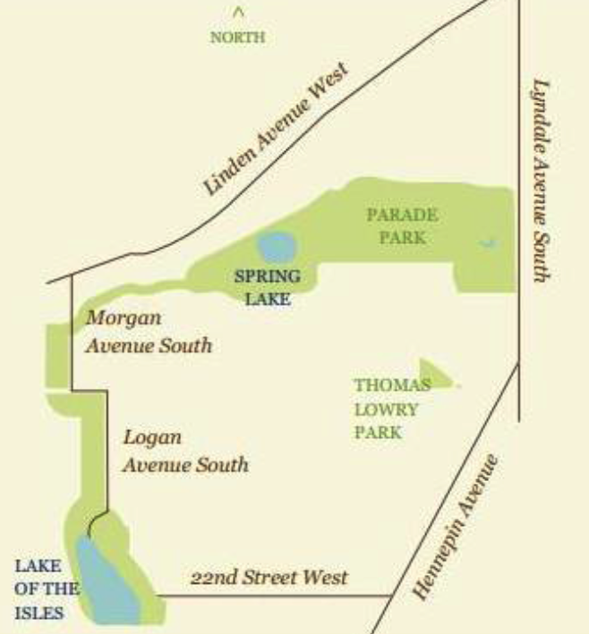
Where is Lowry Hill?

Slide 16
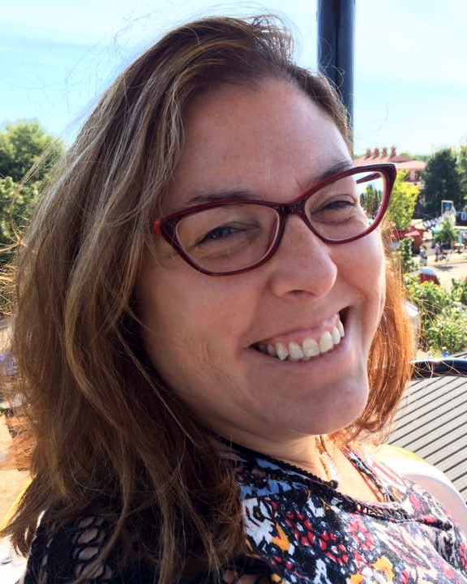
Treasurer’s Report
Toni D’Eramo
Fiscal Year 2020 - 2021
May 1, 2020 – April 30, 2021

Slide 17
LHNA Funding
SOURCES OF FUNDS:
  NRP Neighborhood Revitalization Program
    Supports initial expense for major neighborhood improvement projects
  CPP Community Participation Program
    Supports efforts for outreach and community participation as well as running the neighborhood organization.
  Contributions from residents and businesses
    Ongoing expenses after initial NRP investment, and expenses not reimbursed by CPP
Notes:
This report will be included in the Annual Meeting presentation that will be posted on the LHNA website

Slide 18
LHNA Funding
NRP PROJECT RECAP (OVER LAST 5 YRS)
  Thomas Lowry Park Seven Pools
    Support for the FTLP reconstruction effort of Lowry Hill’s treasured park and help ensure viability for the next 100 years.
    LHNA investment $341,986
  Douglas Median - Hennepin Lyndale Crossroads
    Grew from just LHNA and Douglas Median to a project involving 7 partner organizations, extending improvement/greening all the way to the Basilica.
    LHNA investment $83,424
  Fremont Triangle
    Beautification of a weedy eyesore in the heart of Lowry Hill. This effort was made possible with generous private donations (and labor) in addition to LHNA’s commitment.
    LHNA investment: 3,825

Slide 19
Fiscal Year End Statement of Activity 5/1/2020 - 4/30/2021
REVENUE
Individual/Small Business Donations | $1,341.00
Total Reimbursed CPP Expenses | $13,550.00
Total Reimbursed NRP Expenses | $3,892.00
Other Revenue - Interest received | $36.41
Total Revenue | $18,819.46
Note: 4/30/20, the last day of our previous fiscal year, $68,000 in Reimbursed NRP expenses were received

Slide 20
Fiscal Year End Statement of Activity
5/1/2020 - 4/30/2021
EXPENDITURES
Accounting/Bookkeeping | $340.00
Donation to Hill & Lake Press, Dunwoody | $1,100.00
Insurance | $1,812.68
Meetings & Events* | $950.00
Print & Web Production, Media space | $7,062.28
Tax Filing Fee | $40.00
Web & Email Hosting/Software | $711.98
Total CPP Expenses | $11,916.94
Hennepin/Lyndale Crossroads | $7,500.00
MPD Security Cameras for Hennepin Ave. | $28,000.00
TL Park $25k Match Incentive | $25,000.00
Total NRP Expenses | $60,500.00
Thanksgiving pies for MPD | $250.00
Total Unrestricted Expenses | $250.00
TOTAL EXPENDITURES | $72,667.00

Slide 21
Fiscal Year End Statement of Assets and Liabilities as of April 30, 2021
Assets
Checking Account
Unrestricted Funds |  | 33,978.22
Restricted - 2022 Commitment to Hennepin/Lyndale Crossroads |  | 3,892.42
Total Checking |  | 37,870.64
Propel nonprofits loan receivable 3/31/22 (not including interest at 1.5%) |  | 94,500.00
Total All Assets |  | 132,370.64
Liabilities
Accounts Payable - 2022 Green Minneapolis Hennepin/Lyndale Crossroads |  | 3,892.42
CPP refundable advance |  | 4,200.00
Total Liabilities |  | 8,092.42

Slide 22
LHNA Future Funding
CPP Transition to Neighborhoods 2020
  Base funding decreasing
    $17,000 2017-2020 annual reimbursement
    $17,311 2021allocation
    $15,000 2022 allocation
    $10,000 2023 allocation
  New, added compliance rules
    Will take some of the funding/resources
  Opportunities for incremental funds:
    Equitable Engagement Fund
    Partner Engagement Fund
    Need substantial volunteer time to create and submit plans for funding consideration
    Consider volunteering!

Slide 23
LHNA Future Funding
NRP Neighborhood Revitalization Program
  Not “done”
    but uncertain how it will be executed in the future
  State Law requires the funds to be used exclusively for NRP purposes
    but distribution of NRP funds is a Policy Board issue
  The City could decide
    to redistribute NRP funds between neighborhoods or
    to revise the program - within the context of the State Law.
  Even with changes, NRP funds can only be used for NRP purposes
  July 2021
    Neighborhood & Community Relations (NCR) says it will be returning to the City Council in July 2021 to recommend changes to the NRP State Law.
  It will be well worth it to keep an eye on that process.

Slide 24
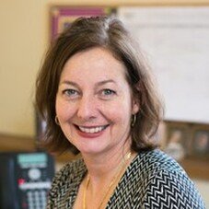
Election: LHNA Board
Janet Hallaway
LHNA Board Member + Nomination Committee

Slide 25
Elections & Terms
Board members serve 2-year terms
Maximum 3 consecutive terms
Special thanks to departing members:
  Lee Switzenberg

Slide 26
Returning board members
Will serve 2nd year of 2-year term
  Justin Baylor
  Vickie Bennett
  Kathleen Bottini
  Jennifer Breitinger
  Fran Davis
  Toni D’Eramo
  Janet Hallaway
  Robert Hinck
  John Lillihei
  George Montague
  Chas Scheiderer
  Sue Westerman

Slide 27
Proposed Slate for New Term
Candidates for election
  Tyler Ecklund
  Thomas Regnier*
  Craig Wilson*
  *returning

Slide 28
A few things before adjourning…
Jennifer Breitinger
LHNA Board President

Slide 29

Want to Get Involved?
  Talk to a Board member tonight
  Come to meetings: 1st Tuesdays, September through June, Kenwood Rec Center, 7PM or Zoom
  Email us lhna@lowryhillneighborhood.org

Slide 30
LHNA always accepts your tax-deductible contributions
We value and welcome everyone in our community!
Thanks for your interest
Thanks for your participation
Thanks for your continued Financial support
-And-
THANK YOU for your presence here tonight!
LHNA
P.O. Box 3978
Minneapolis, MN 55403
Or visit www.lowryhillneighborhood.org

Slide 31

Thank You! and please…
Remember to
Leave a
Light On!

