Slide 1

2019 Annual Meeting
May 14, 2019

Slide 2
Tonight’s Agenda
Welcome
Guest Speakers
  Mary Ceruti, Exec. Director, Walker Art Center
  Scott Dibble, MN State Senator
  Frank Hornstein, MN House Representative
About LHNA
Treasurer Report
Committee Updates
Election of Board Members

Slide 3
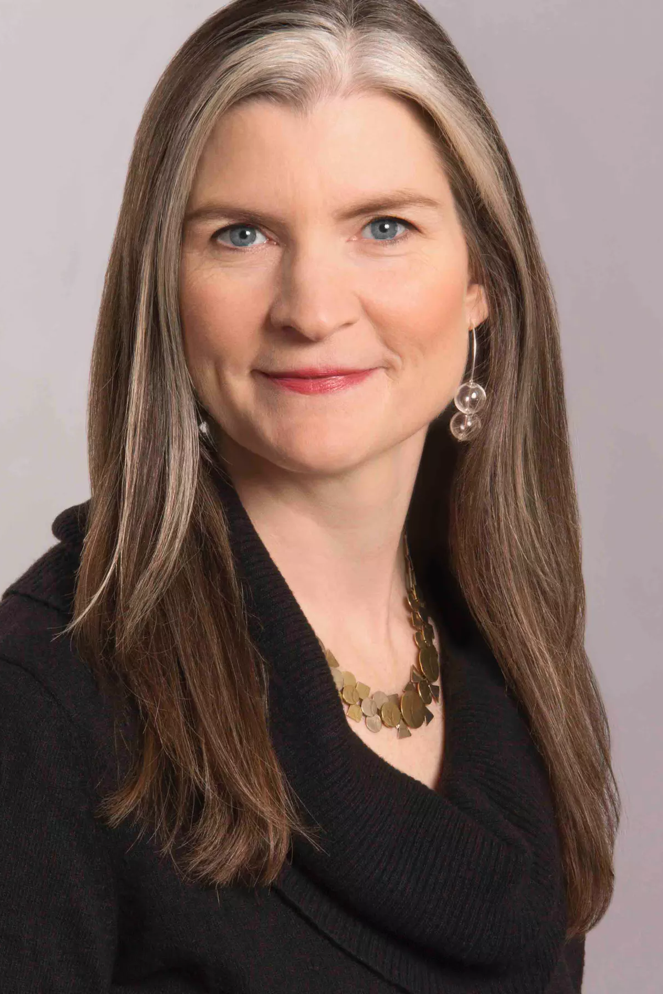
Walker Art Center Welcome
Mary Ceruti

Slide 4
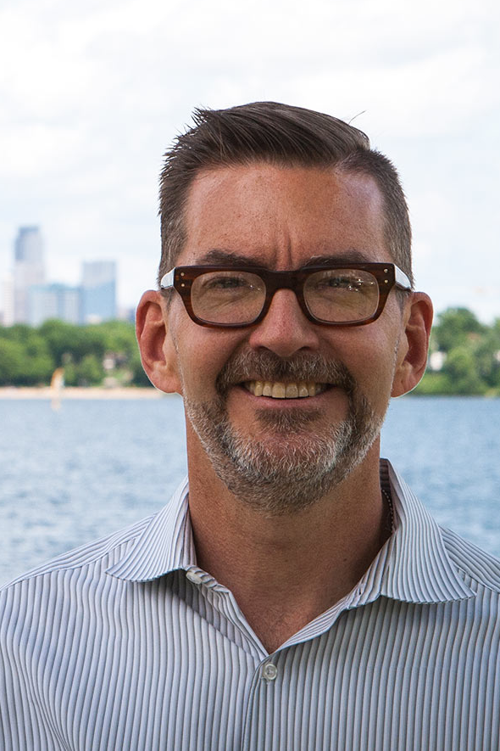
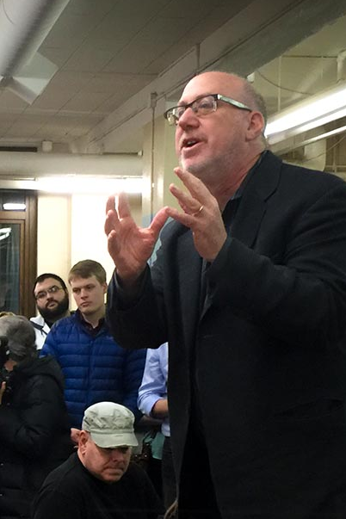
MN State
Senator
Scott Dibble
MN House
Representative
Frank Hornstein

Slide 5
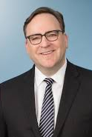
What is LHNA?
Board President, Michael Cockson

Slide 6
What is LHNA?
Neighborhood organization
  501(c)3
  Dedicated to addressing issues affecting Lowry Hill residents and businesses

Slide 7
What is LHNA?
Develops,
Encourages
and Promotes…
Programs, activities, and actions directed to the preservation, maintenance, improvement
and beautification of Lowry Hill.

Slide 8
What is LHNA?
Board of Directors
  15 members
  All volunteers
  Elected by residents

Slide 9
Current Board
Executive Committee
Michael Cockson, President
Robert Hinck, Vice President
Toni D’Eramo, Treasurer
Chas Scheiderer, Secretary
Board Members
Justin Baylor
Kathleen Bottini
Jennifer Wirick Breitinger
Clint Conner
Fran Davis
Krishna Dorney
Sam Ellingson
Evan Stern
Lee Switzenberg
Craig Wilson

Slide 10
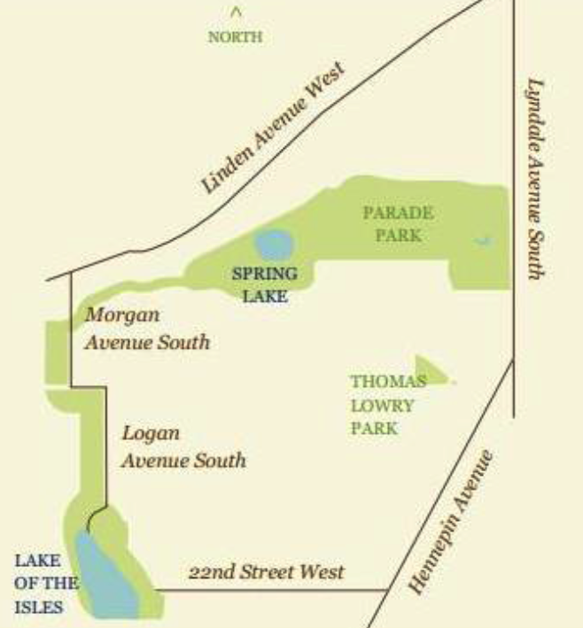
Lowry Hill Map

Slide 11
Who Lives Here?
3,834 people
  11% < 17 years old
  75% 18-64 years old
  14% 25-34 years old
2,323 housing units
55% renters / 45% owners
MN Compass 2017
https://www.mncompass.org/profiles/neighborhoods/minneapolis/lowry-hill
Notes:
4,000 people
Approx 2,000 are 25-44 years old
Approx 1,500 are 45-64 years old
Approx 500 are 65+ years old
70% renters
30% homeowner occupancy

Slide 12
Highlights
Propel Nonprofits
  $94,500 committed to affordable housing
Homeowner Navigation Program
  Committed $10,000 to Pilot Project to Provide Emergency Resources to Homeowners in Need
Douglas Median
Fremont Triangle
Franklin-Bryant Median
Thomas Lowry Hill Park
  Committed up to $300,000 to replace the fountain

Slide 13
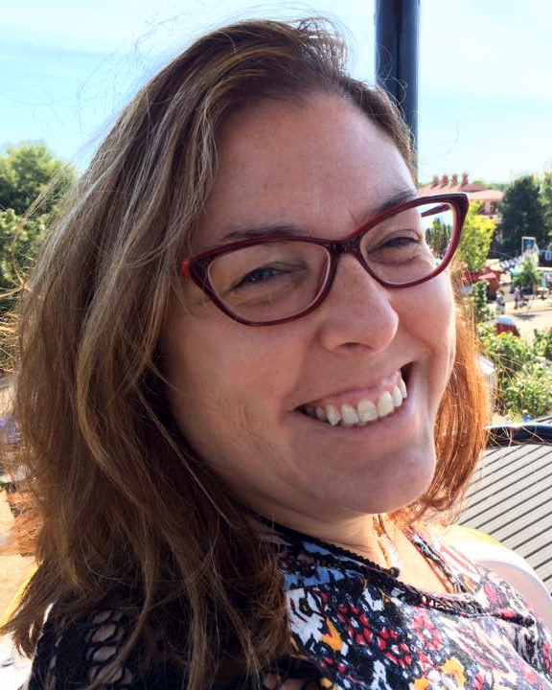
Treasurer’s Report
Toni D’Eramo

Slide 14
LHNA Funding
Contributions
  Residents and businesses
City of Minneapolis Funds
  CPP
    Community Participation Program Events, outreach and administration.
  NRP
    Neighborhood Revitalization Program
    Capital and admin expenses for major neighborhood improvement projects.
LHNA designates how these will be spent, within certain guidelines.

Slide 15
Sources of Funds
FY2018 May 1, 2018 – Apr 30, 2019
Lowry Hill Residents/Businesses $ 4,247
City Funding NRP $ 58,078
City Funding CPP $ 14,304
Bank Account Interest $ 26
Franklin Bryant Median $ 1,450
Total Funds Received $ 78,105

Slide 16
Use of Funds
FY2018 May 1, 2018 – Apr 30, 2019
NRP $ 58,078
  Douglas Median/Hennepin-Lyndale,
  TLP assessment
CPP $ 14,304
  Administrative, Staff, Supplies
  Outreach, Communications, Insurance
Douglas Median $ 2,500
  2019 maintenance contribution
Other Expenses $ 2,195
  Event entertainment, event food
Franklin-Bryant Median $ 1,300
  LHNA handled funds/payments _______
TOTAL FUNDS EXPENDED $ 78,377

Slide 17
Sources vs Uses LHNA Funds
FY2018 5/1/18 - 4/30/19
Sources of Funds $ 78,105
Uses of Funds $ 78,377
Sources vs. Uses $ (272)

Slide 18
Crime & Safety Committee
Chair: Lee Switzenberg

Slide 19
LHNA Committee Updates
Crime & Safety
Events
Zoning
Neighborhood Priorities
Environment
Historical
Communications

Slide 20
Crime & Safety
Areas of Focus
  Crime prevention
  Recruit block leaders
  Encourage action from residents to reduce crime

Slide 21
Crime & Safety
Overall, Lowry Hill is a low crime area
  94% property crime (mostly theft)
  6% violent crime

Slide 22
2016 vs 2017

Slide 23
What Can You Do?
Do not hesitate. Call 911
  Renters and homeowners
  Increased calls = better tracking for areas of crimes, trends, increased patrols
  Suspicious behavior? Still make the call. If it is not an emergency
    Say “not an emergency”
    Wait for operator to say “ok go ahead"

Slide 24

What Can You Do?
Leave A Light On
  Leave porch lights on front and back.
  All night.
Lock your
  1st floor windows
  Cars and bikes
  Garage doors
  Don’t leave valuables in your car
  Always arm your security system
Sign up for the city’s crime alerts
  See link in LHNA email newsletters

Slide 25
Events Committee
Chair: Justin Baylor

Slide 26

LHNA Events
Annual meeting every May
Ice Cream Social every July
  Save the Date! 7/16/19
Notes:
Tuesday July 16 2019 at Thomas Lowry Park – save the date. Free ice cream and root beer floats for Lowry Hill residents

Slide 27
LHNA Events
Walking Tours for Lowry Hill Residents
  Historic Lake of the Isles
    Annual event
    Coming up 6/2/19
    See website for details.
  NEW! Historic Lowry Hill
    Was 5/4/19

Slide 28
LHNA Events
Fall Neighborhood Garage Sale
  Together with EIRA
  2018 was Sept 8
  2019 date to be set
  Watch LHNA email news for details

Slide 29
LHNA Events
Thrill Kenwood every October

Slide 30
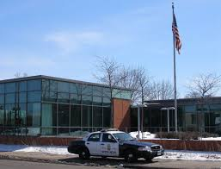
LHNA Events:
Thanksgiving “Thank You”
  LHNA Board delivers pie and ice cream to 5th Precinct police and fire station on Thanksgiving Day.

Slide 31

LHNA Events
Lake of the Isles Skating Party every January
  With Kenwood, East Isles & CIDNA

Slide 32
Neighborhood Events
More to come!
Sculpture Garden Tour
Dunwoody Institute Tour
Watch the LHNA email news for details

Slide 33
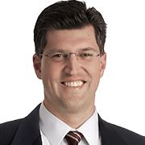
Zoning Committee
Chair: Clint Conner

Slide 34
Zoning Committee
Areas of Focus
Variance requests

Slide 35
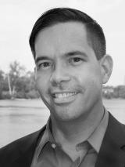
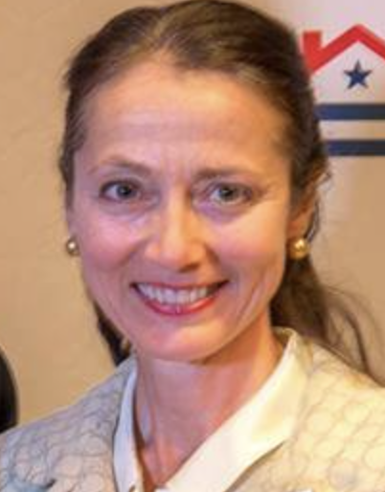
Neighborhood Priorities Committee
Co-Chairs:
Craig Wilson + Jennifer Breitinger

Slide 36
Neighborhood Priorities Committee
Areas of Focus
  Douglas Median + Hennepin-Lyndale Crossroads
  Fremont Triangle
  Bryant Median
  Thomas Lowry Park Evaluation + Funding of Seven Pools

Slide 37
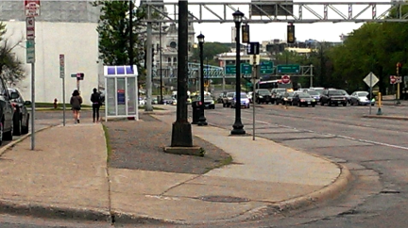
Douglas Median before…

Slide 38
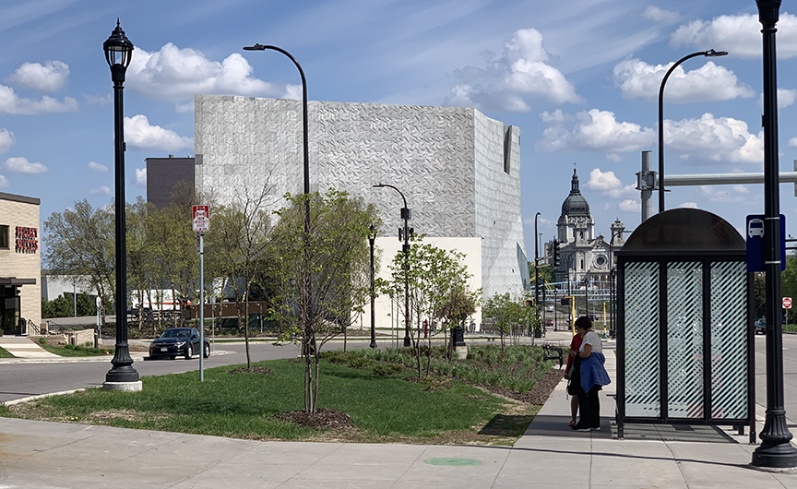
Douglas Median after…
Add Photo

Slide 39
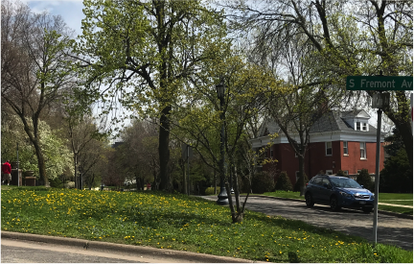
Fremont Triangle, before…

Slide 40
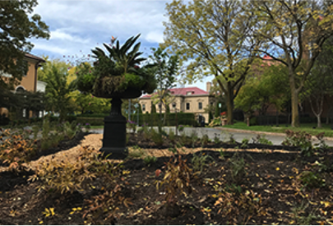
Fremont Triangle, after…

Slide 41
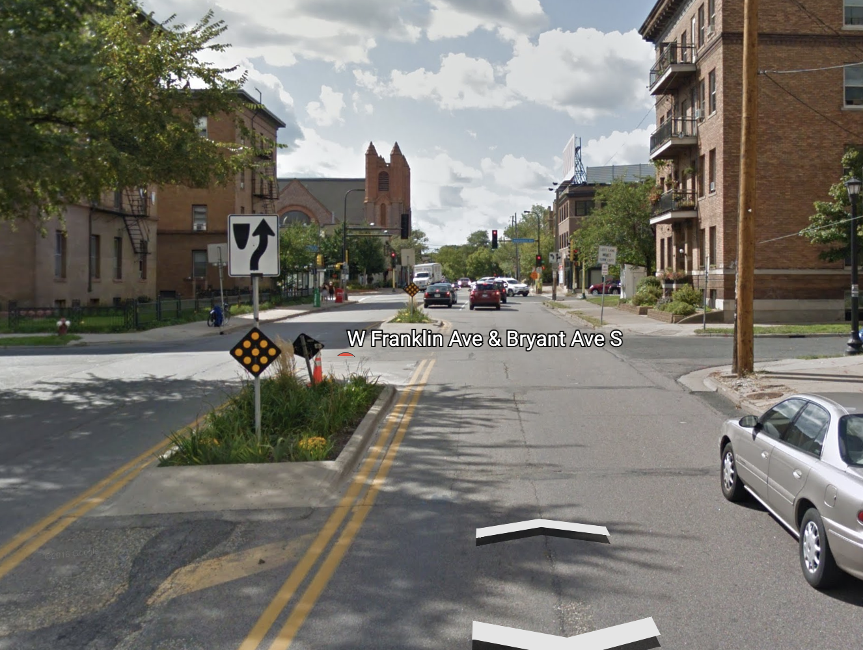
Bryant Median, before…

Slide 42
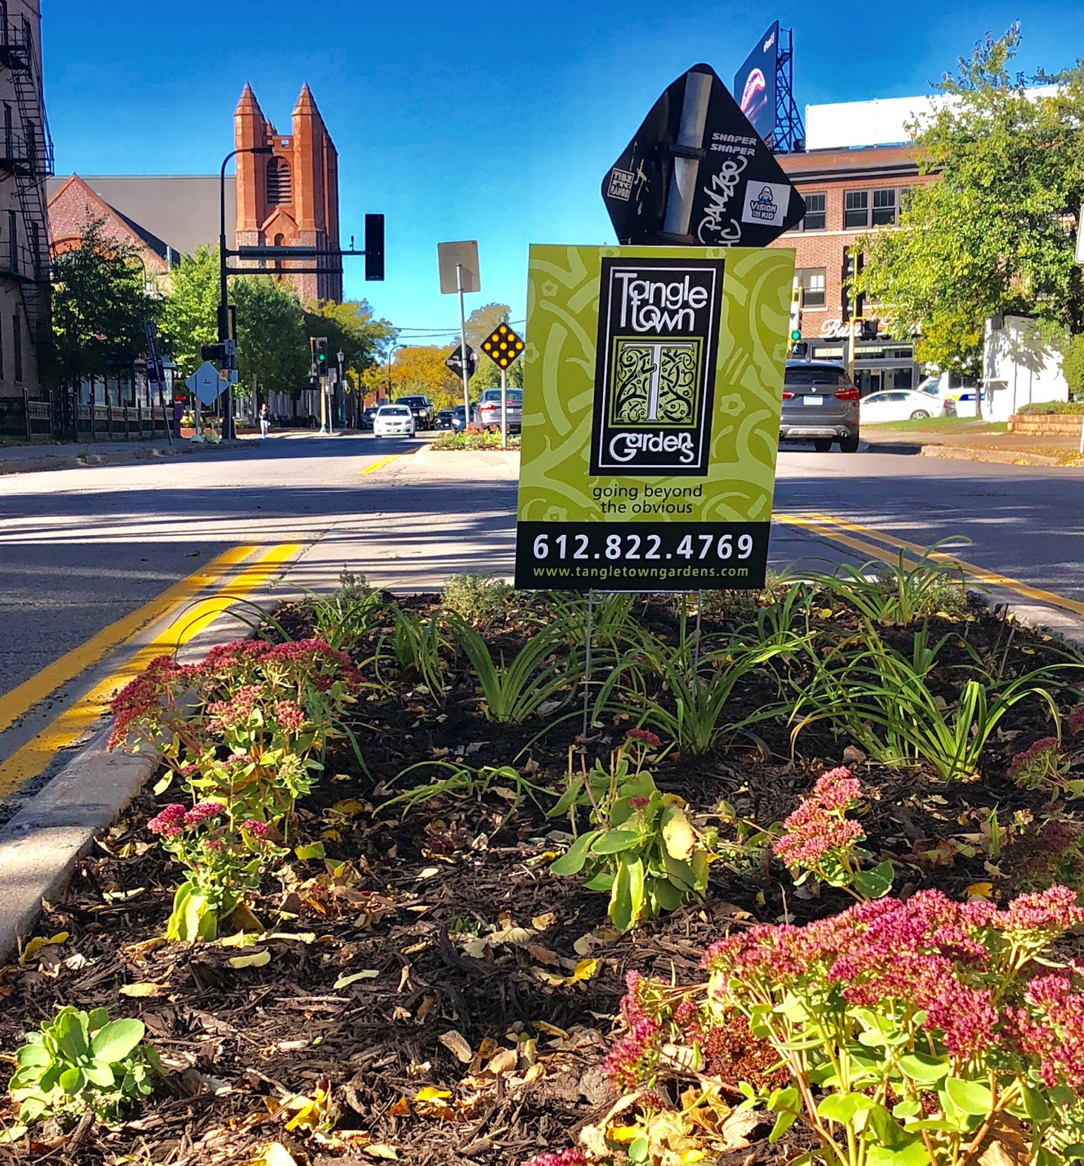
Bryant Median, after…

Slide 43
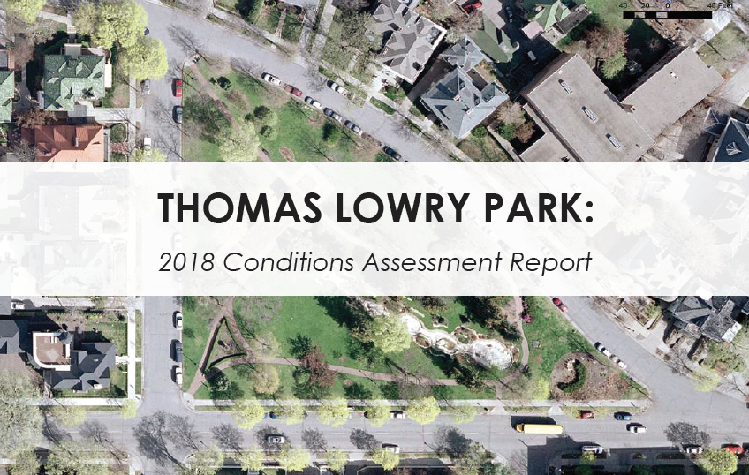
  Thomas Lowry Park Evaluation + Funding of Seven Pools

Slide 44
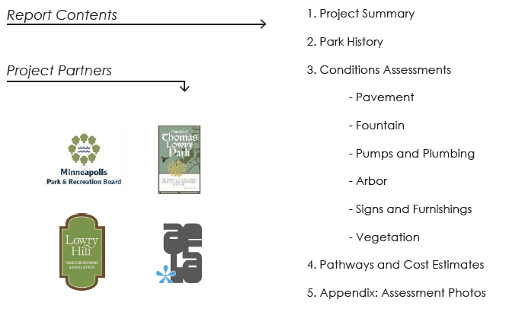
  Thomas Lowry Park Evaluation + Funding of Seven Pools

Slide 45
Thomas Lowry Park
Restoration Plan
  LHNA hires Aune Fernandez Landscape Architects to assess features of Thomas Lowry Park – recommend complete replacement of Seven Pools
  LHNA board considers allocating NRP funds to work on Seven Pools, engages Friends of Thomas Lowry Park Board about idea
  MPRB and the SWCAC release a design option for Thomas Lowry Park that called for removing the water from Seven Pools
  Strong Lowry Hill community reaction against the idea of dry pools filled with sand
  Lowry Hill community votes to spend $300,000 in NRP funds on restoration Seven Pools
  FTLP agrees to spearhead a fundraising campaign to help MPRB replace the almost century old pools.

Slide 47
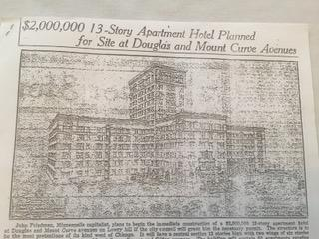
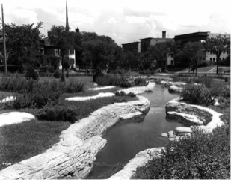
Legacy of Thomas Lowry Park
And Seven Pools
Public-private partnership
1922 historic design
Backdrop for generations of memories and events

Slide 48
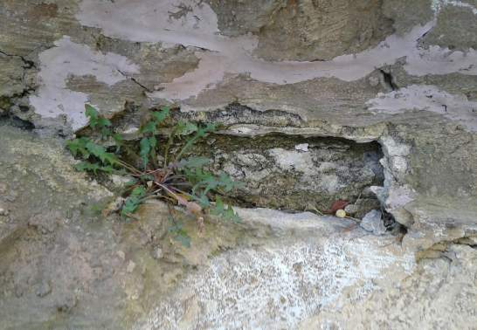
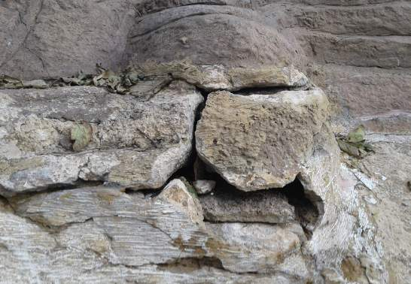
Mismatched patching
Sections likely to fail

Slide 49
Seven Pools Project
Our Goal
Funding
LHNA | $300,000
FTLP | $250,000 - $300,000
MPRB | $150,000 - $200,000
 | $750,000
$350,000

Slide 50
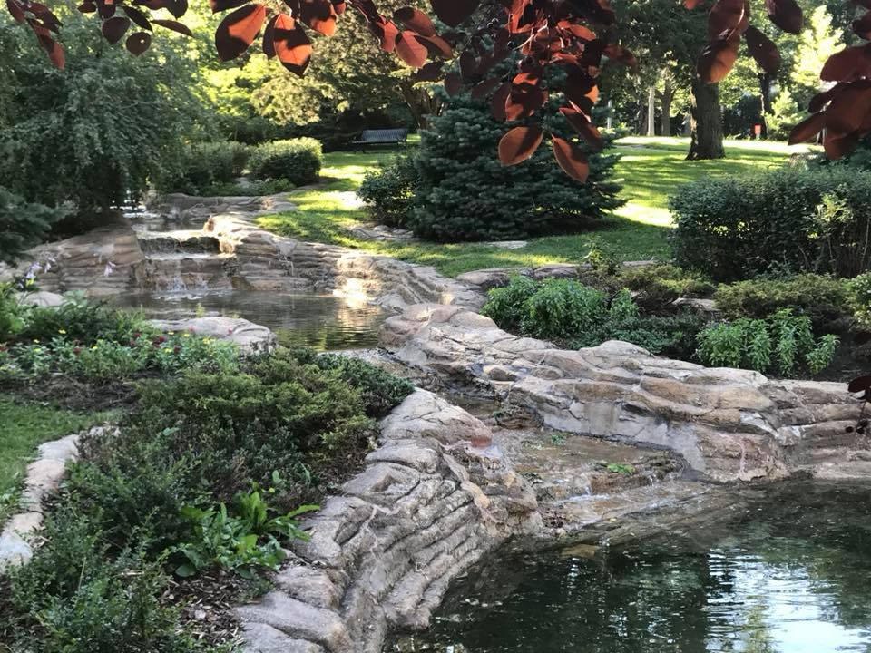
Save the Seven Pools
TIMELINE
Summer 2019
Finalize design (geotechnical assessment, 3D modeling)
Select construction vendor
Fall 2019 / Early 2020
Begin demolition and reconstruction

Slide 51
$92,150
pledged to date!

Slide 52
Friends of Thomas Lowry Park
Board Members
Kathleen Bottini
Kathy Gaskins
Barry Lazarus
Margaret Lett
Suzanne Payne
Paul Pender
Jeanne Scheiderer
Elizabeth Shaffer
Tom Trondson
Craig Wilson
thomaslowrypark.org

Slide 53
Environment Committee
Chair: Robert Hinck

Slide 54
Environment Committee
Areas of Focus
Safeguard & preserve the natural resources in Lowry Hill
Encourage residents to Reduce, Reuse and Recycle
Keep informed of neighborhood park plans and environmental issues

Slide 55
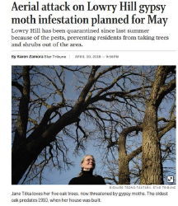
Environment Committee
Gyspy moth quarantine
  All clear

Slide 56
Three Things You Can Do
Make picnics and parties low waste.
  Compost paper napkins, food scraps
  Use certified compostable cups plates utensils
    Available at the Wedge!
Call upon Hennepin County’s Master Recycler volunteers to help with large events
Sign up for organics recycling

Slide 57
Historical Committee
Chair: Krishna Dorney

Slide 58
Historical Committee
Preserve and maintain the historical character of Lowry Hill
Assist residents with researching the history of their homes
  “Researching Your Historical Home information (pdf)” on the LHNA website

Slide 59
Communications & Outreach
Chair: Toni D’Eramo

Slide 60
Communications
Areas of focus
Share LHNA information with residents
Encourage neighborhood involvement
Notes:
Our areas of focus are to
encourage neighborhood involvement
share information with residents
How do we share information?

Slide 61
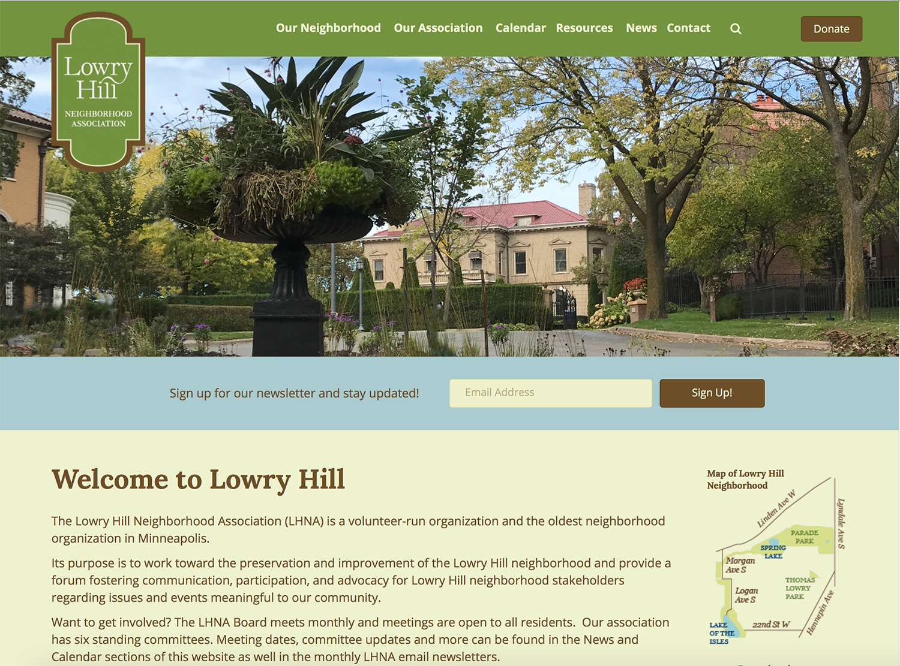
LHNA Website
lowryhillneighborhood.org

Slide 62
LHNA Monthly Email Newsletter
Easy sign up on web site
Neighborhood events and news
Environment news
Road construction updates
Crime maps
Meeting information
Notes:
Monthly emails –
Upcoming events, environmental news, construction updates, board meeetings and more
if you do not receive these, sign up at our web site lowryhillneiighborhood.org

Slide 63

Hill & Lake Press Ads

Slide 64
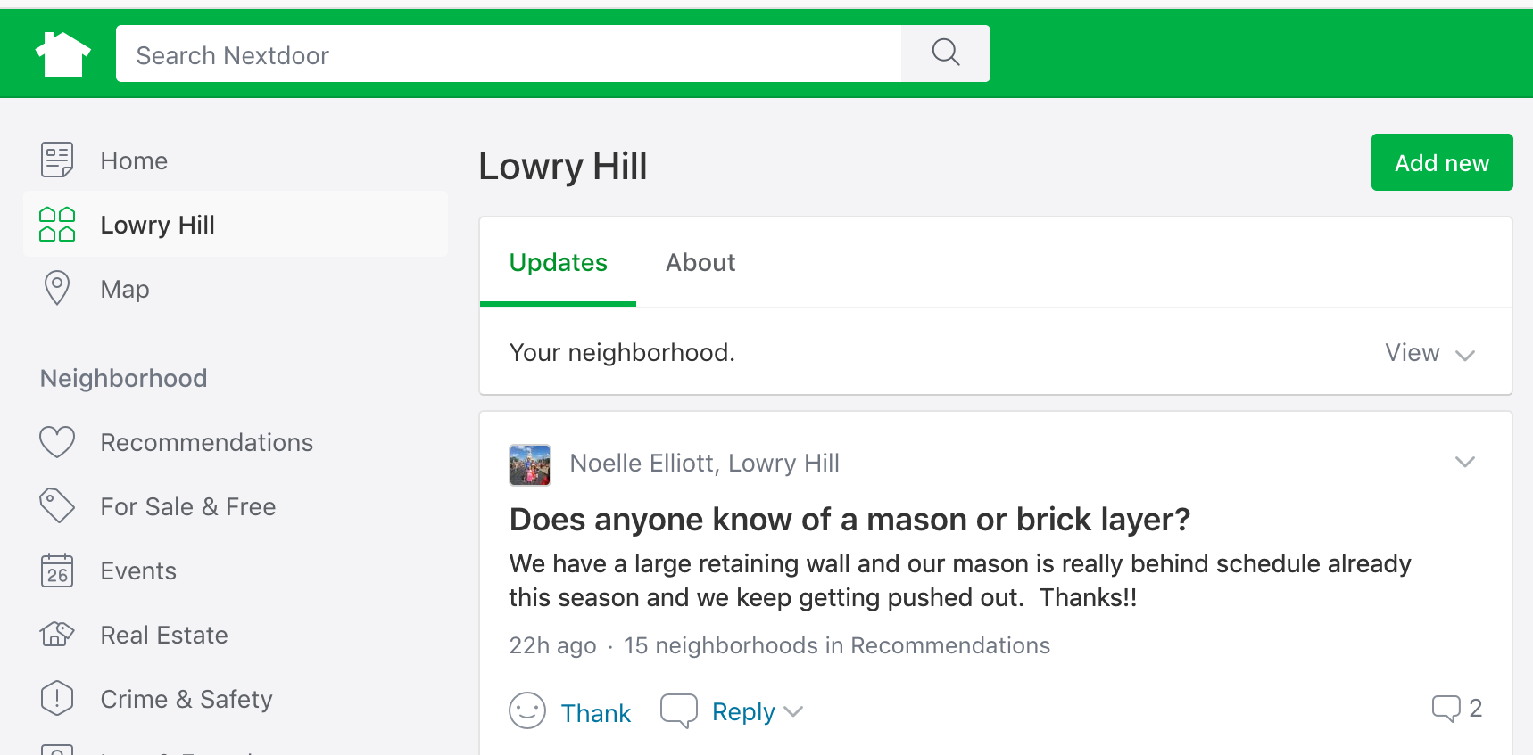
nextdoor.com
Notes:
We also post on Next Door,
a free private social network for your neighborhood community.
And now back to our president Phil Hallaway

Slide 65
Election: LHNA Board
Michael Cockson, President

Slide 66
Elections & Terms
Board members serve 2 year terms
Maximum 3 consecutive terms
Special thanks to departing members
  Michael Cockson
  Clint Connor
  Jimmy Fogel

Slide 67
Returning board members
Will serve 2nd year of 2 year term
  Justin Baylor
  Kathleen Bottini
  Jennifer Breitinger
  Fran Davis
  Toni D’Eramo
  Robert Hinck
  Evan Stern
  Chas Scheiderer

Slide 68
Proposed Slate for New Term
Board members for re-election
  Lee Switzenberg
  Craig Wilson
  Sam Ellingson
New candidates
  Jody Lictor
  Thomas Regnier

Slide 69

Want to Get Involved?
  Talk to a Board member tonight
  Come to meetings: 1st Tuesdays, September through June, Kenwood Rec Center, 7PM
  Email us lhna@lowryhillneighborhood.org

Slide 70
LHNA always accepts your tax-deductible contributions
We value and welcome everyone in our community!
Thanks for your interest
Thanks for your participation
Thanks for your continued Financial support
-And-
THANK YOU for your presence here tonight!

Slide 71
Thank You! and please…
Remember to
Leave a
Light On!

