Slide 1

2018 Annual Meeting
May 15, 2018

Slide 2
Agenda
First Unitarian Society Welcome
In Memoriam - Sarah Janecek
Council Member - Lisa Goodman
State Senator - Scott Dibble
Guest Speaker - Jacob Frey
About LHNA
Treasurer Report
LHNA Committee Updates
Election of Board Members

Slide 3
First Unitarian Society Welcome
Tim Roehl

Slide 4
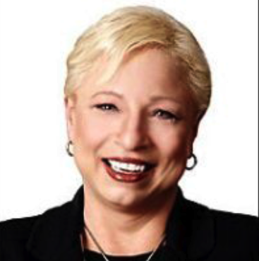
In Memoriam
Sarah Janecek
Dec.27,1960 - January 12, 2018

Slide 5
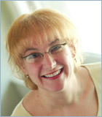
Lisa Goodman
7th Ward Council Member

Slide 6
Scott Dibble
State Senator

Slide 7
Guest Speaker
Mayor Jacob Frey

Slide 8
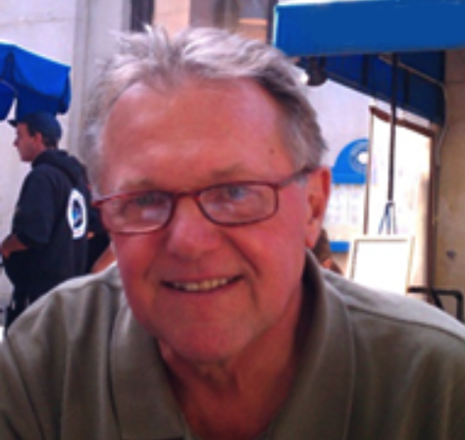
What is LHNA?
Board President, Phil Hallaway

Slide 9
What is LHNA?
Neighborhood organization
  501(c)3
  Dedicated to addressing issues affecting Lowry Hill residents and businesses

Slide 10
What is LHNA?
Develops,
Encourages
and Promotes…
Programs, activities, and actions directed to the preservation, maintenance, improvement
and beautification of Lowry Hill.

Slide 11
What is LHNA?
15 member Board of Directors
  All volunteers
  Elected by residents

Slide 12
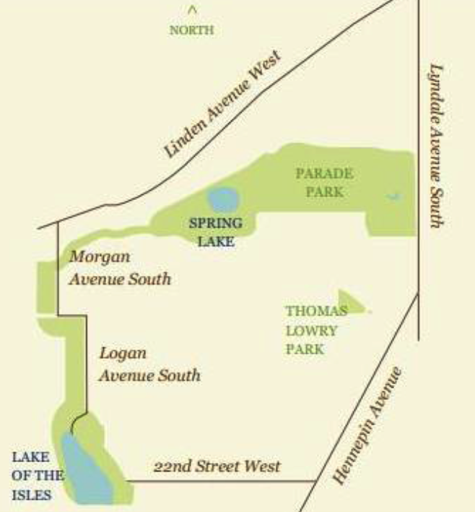
Lowry Hill Map

Slide 13
Who Lives Here?
3,854 people
  75% are 18-64 years old
  25% are 25-34 years old
  88% white
2,341 housing units
1,022 rented units in apartments
60% renter-occupied units
Notes:
4,000 people
Approx 2,000 are 25-44 years old
Approx 1,500 are 45-64 years old
Approx 500 are 65+ years old
70% renters
30% homeowner occupancy

Slide 14
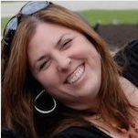
Treasurer’s Report
Toni D’Eramo

Slide 15
LHNA Funding
Our Own Funds
  Contributions from Lowry Hill residents, businesses, other neighborhood organizations.
City of Minneapolis Funds
  Community Participation Program (CPP)
    Supports some expenses for Lowry Hill events, outreach and administration.
  Neighborhood Revitalization Program (NRP)
    Supports capital expenses and related administrative support for major neighborhood improvement projects.
  We designate how these will be spent,
  within certain guidelines.

Slide 16
LHNA Funding
Lowry Hill Residents/Businesses $ 3,364
City Funding CPP $ 29,215
City Funding NRP $ 19,530
Other Neighborhood Orgs. $ 240
Bank Account Interest $ 18
Reserve Funds Janecek Memorial $ 1,935
Total Funds Received $ 54,302
May 1, 2017 – Apr 30, 2018

Slide 17
Uses of LHNA Funds
Event and Program Expense $ 3,577
  Annual Meeting, Ice Cream Social
  LH Garage Sale, Candidate Forum
NRP $ 20,030
  Fremont Triangle
  Hennepin-Lyndale/Douglas Median
Outreach & Donations $ 13,764
  Housing Alliance, Thrill Kenwood
  Communications, Website,
  Email, Hill & Lake Press
  Thanksgiving pies for Fire Dept.
Administrative Expenses $ 4,234
  Insurance, Staff ______________
TOTAL FUNDS EXPENDED $ 41,605
May 1, 2017 – Apr 30, 2018

Slide 18
Sources vs Uses LHNA Funds
Sources of Funds $ 54,302
Uses of Funds $ 41,605
Sources vs. Uses $ 12,697
5/1/17-4/30/18
Bank Balance, May 1, 2017 $ 23,252
Bank Balance, April 30, 2018 $ 35,949

Slide 19
Crime & Safety
Committee
Chairs: Lee Switzenberg
Jimmy Fogel

Slide 20
Crime & Safety
Areas of Focus
Crime prevention
Recruit block leaders
Encourage action from residents to reduce crime

Slide 21
Crime & Safety
Overall, Lowry Hill is a low crime area
  94% property crime (mostly theft)
  6% violent crime

Slide 22
2016 vs 2017

Slide 23
What Can You Do?
Do not hesitate. Call 911
  Renters and homeowners
  Increased calls = increased patrols
  If it is not an emergency…still make the call
    Say “not an emergency”
    Wait for operator to say “ok go ahead”

Slide 24

What Can You Do?
Leave A Light On
  Leave porch lights on
  Front and back.
  All night.
Lock your
  1st floor windows
  Cars and bikes
  Garage doors
  Don’t leave valuables in your car
  Always arm your security system
Sign up for the city’s crime alerts
  See link in LHNA email newsletters

Slide 25
Events Committee
Chairs: Tom Huppert
Evan Stern

Slide 26
LHNA Events
2017 Annual Meeting
May 16, 2017

Slide 27
LHNA Events
Walking Tour
  Historic Lake of the Isles
  Sunday, June 25, 2017

Slide 28

LHNA Events
Lowry Hill Ice Cream Social
July 11, 2017
This year: July 17, 2018

Slide 29
LHNA Events
Neighborhood Garage Sale
Saturday Sept 9, 2017
Volunteers needed for this year
Watch LHNA email news for details

Slide 30
LHNA Events
“Thrill Kenwood”

Slide 31
LHNA Events
7th Ward Council Candidates Forum
September 27, 2017
Co-sponsored with 4 other neighborhood associations
Moderated by League of Women Voters

Slide 32
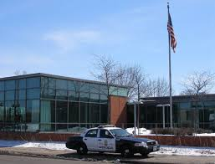
LHNA Events:
Thanksgiving “Thank You”
  LHNA Board delivers pie and ice cream to 5th Precinct police and fire station on Thanksgiving Day.

Slide 33

Events: January 21, 2018
Lake of the Isles Skating Party
  with Kenwood, East Isles & CIDNA

Slide 34
Neighborhood Events
More to come!
Sculpture Garden Tour
Dunwoody Institute Tour
Watch the LHNA email news for details

Slide 35
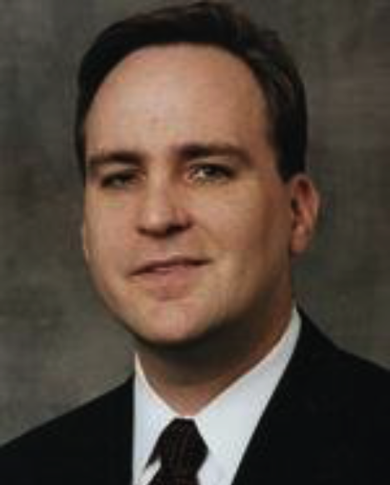
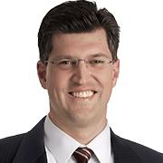
Zoning Committee
Chairs: Michael Cockson & Clint Conner

Slide 36
Zoning Committee
Areas of Focus
Variance requests
Parking challenges at Hennepin & Franklin

Slide 37
PERIS HousingProject
1930 Hennepin

Slide 38
PERIS Project
41 unit apartment complex financed and developed by Graves Foundation and Graves Hospitality, respectively
15 supportive housing units for foster youth
26 affordable housing units for low-income youth
Maximum occupancy will be 2 persons per unit

Slide 39
May 1, 2018
LHNA Board gave conditional approval to new design that addressed a number of neighborhood concerns
Entrance/exit on Hennepin
Curb cut removed on Colfax
Softening of the rear of the building

Slide 40
PERIS Timeline
June, 2018 - Apply to City for tax credits
Secure financing
Spring, 2019 - Begin Construction

Slide 41
Neighborhood Priorities Committee
Chair: Craig Wilson

Slide 42
Neighborhood Priorities Committee
Areas of Focus
  Douglas median landscape: Completion this summer!
  Emerson triangle
  Bus stops
  Future: Thomas Lowry Park

Slide 43
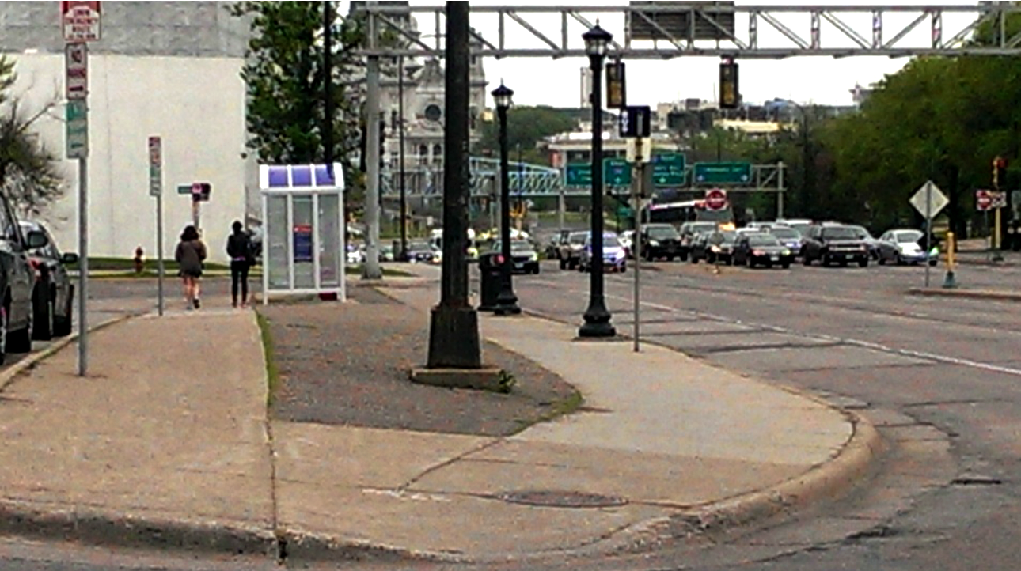
Douglas Median before…

Slide 44
Douglas Median after…
Add Photo

Slide 45
Emerson Triangle, before…

Slide 46
Emerson Triangle, after…

Slide 47
Environment Committee
Chair: Bob Hinck

Slide 48
Environment Committee
Areas of Focus
Safeguard & preserve the natural resources in Lowry Hill
Encourage all residents to Reduce, Reuse and Recycle
Keep informed of neighborhood park plans and environmental issues
Notes:
Our areas of focus are to
Safeguard and preserve natural resources in Lowry Hill, like Thomas Lowry Park
Encourage all residents to REDUCE REUSE RECYCLE
Be informed of neighborhood park plans and environmental issues

Slide 49
Environment Committee

Slide 50
Gypsy Moth Quarantine Area

Slide 51
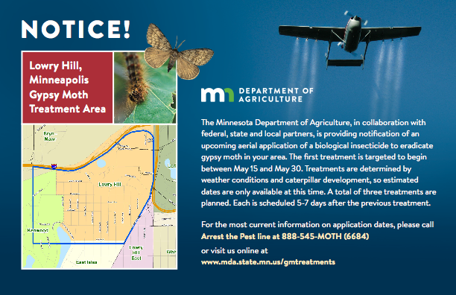
Environment Committee

Slide 52
Gypsy Moth Treatment Area

Slide 53
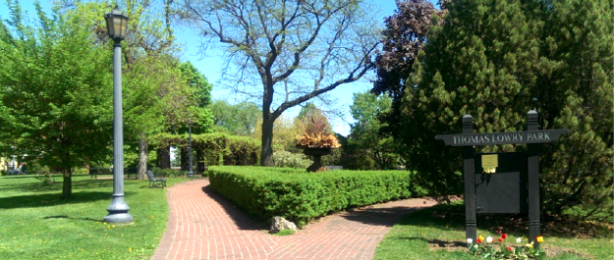
Environment Committee
Natural Resources: Thomas Lowry Park
  Gardening volunteers needed
  1st Saturdays
  May-Oct @ 10am -12 noon
Notes:
Another note on Thomas Lowry Park gardening volunteers are needed!
Anyone interested just show up at the park on the first Saturday of the month from May thru October.
Come at 10am.
Bring your gardening gloves and favorite tools if you have some. If not still show up, there’s plenty to do and tools to share.

Slide 54
Three Things You Can Do:
Make your parties, picnics low waste.
    Recycle cans, bottles
    Compost paper napkins, food scraps
    Use BPI certified compostable cups plates utensils (buy at the Wedge!)
Call upon Master Recycler volunteers for large events
Sign up for organics recycling
Notes:
Three things you can do this summer and fall.
FIRST Whether it is a graduation party or picnic, try to make it a low waste event. Be sure to recycle cans and bottles, and compost used paper napkins and food scraps. Choose BPI certified compostable plates, cups, and utensils (buy at the Wedge!).
We’ll make dirt from the compostable items instead of spending resources to recycle or send them to the landfill.
SECOND – call upon the Master Recyclers who volunteer for large events. They can advise in event planning for low waste and they can be there during the event to help people dispose of things properly. They can also do a Q&A info table like we have here tonite.
THIRD Participate in our neighborhood garage sale- September 9th .

Slide 55
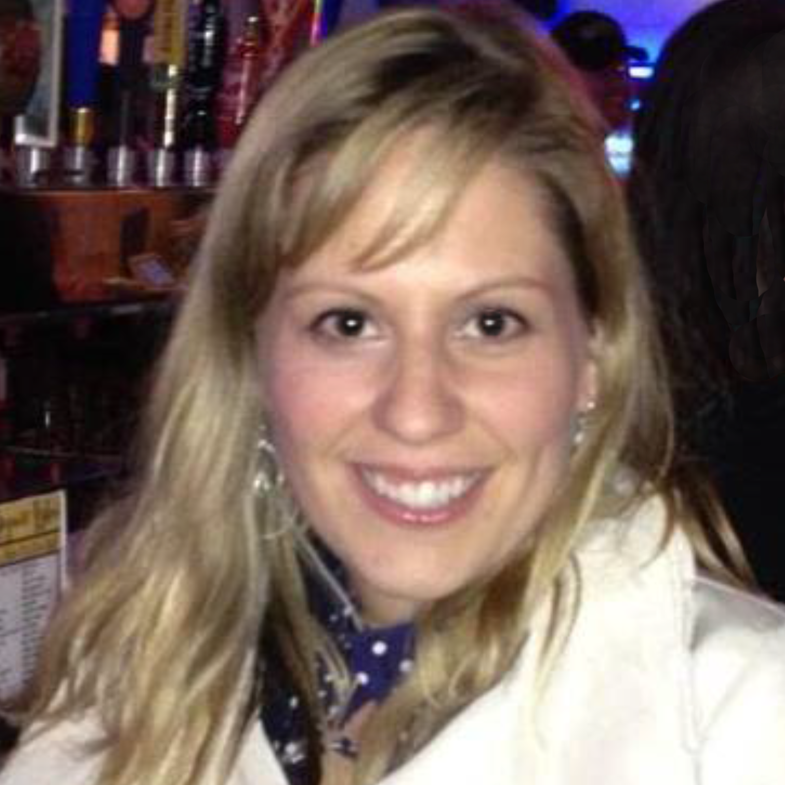
Historical Committee
Chairs:
Emily Beugen & Krishna Dorney

Slide 56
Historical Committee
Preserve and maintain the historical character of Lowry Hill
Assist residents with researching the history of their homes
Researching how a Conservation district could help maintain the important historical aspects of Lowry Hill

Slide 57
Historical Committee
Researching Your Historical Home
Emily Beugen
Notes:
Now Emily will share some great information on how to research your historical home

Slide 58
Historical Committee
Download this information at the
LHNA website

Slide 59
Communications Committee
Communications Committee
Chair:
Toni D’Eramo
Notes:
Hi, I’m Toni and I chair the communications committee. I’d like to give a big thank you to Chris -- she is a talented designer and art director and has been a tremendous help to our board for years! Thank you Chris!

Slide 60
Communications Committee
Areas of focus
Encourage neighborhood involvement
Share LHNA information with residents
Where do we share?...
Notes:
Our areas of focus are to
encourage neighborhood involvement
share information with residents
How do we share information?

Slide 61
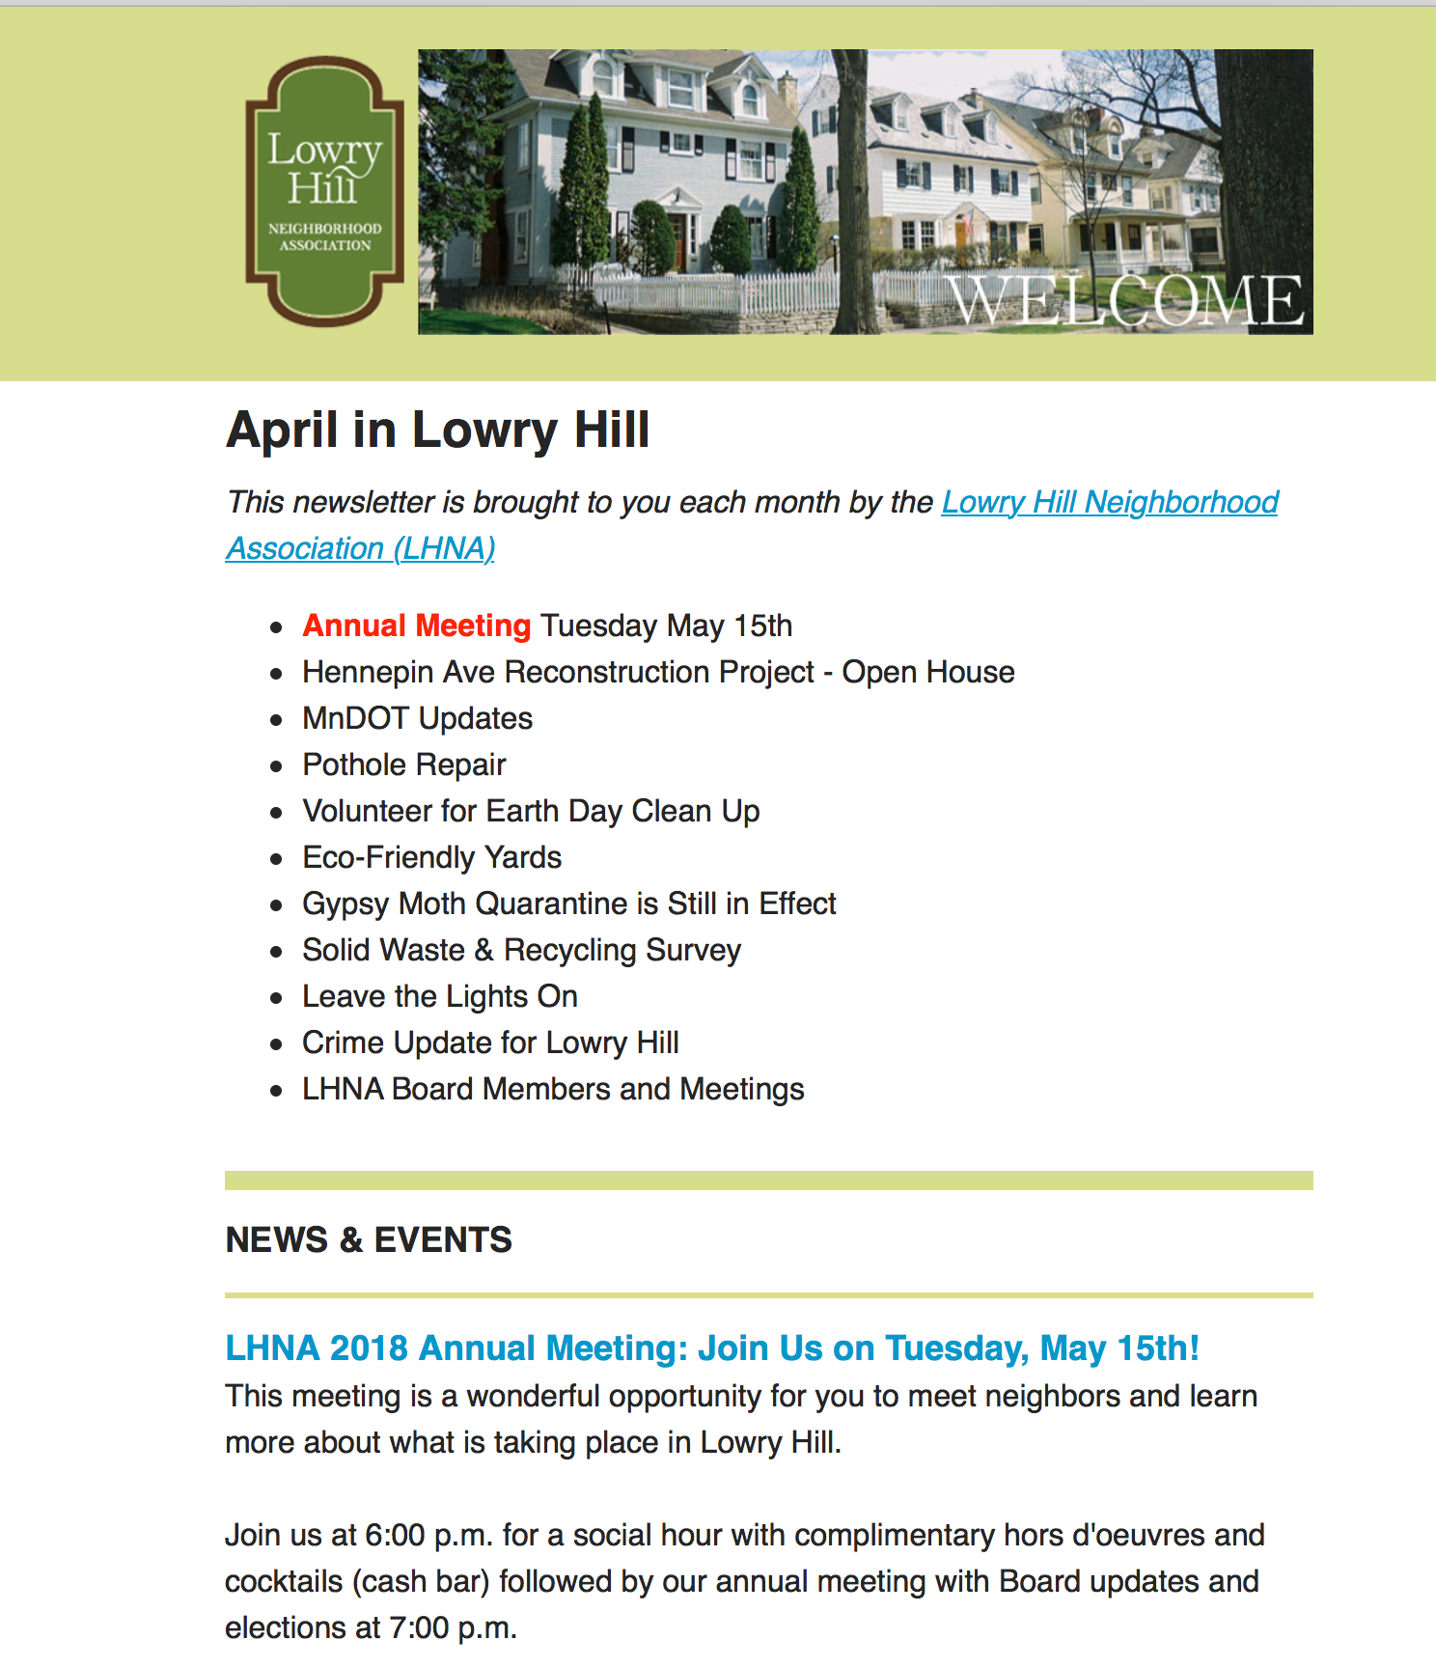
LHNA Monthly Email Newsletter
Residents sign on web site
Neighborhood Events
Environment
Road construction
Crime
Board Meetings
Notes:
Monthly emails –
Upcoming events, environmental news, construction updates, board meeetings and more
if you do not receive these, sign up at our web site lowryhillneiighborhood.org

Slide 62
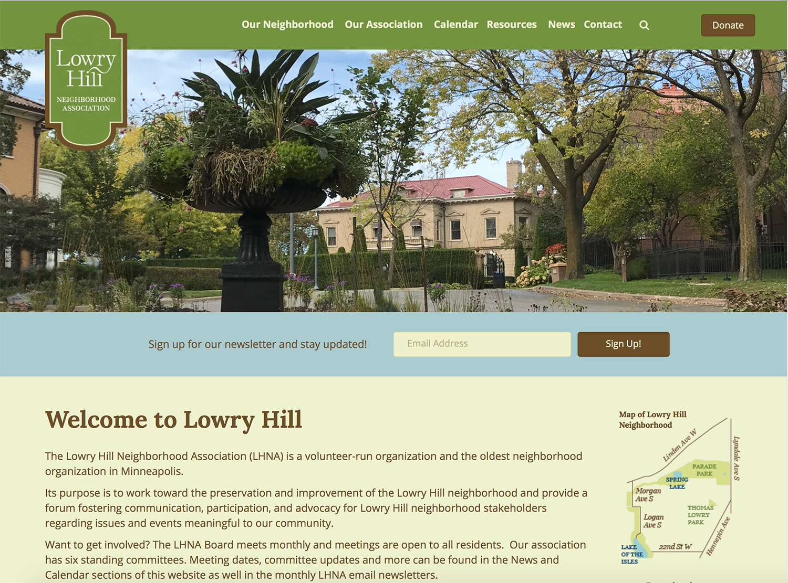
LHNA Website
Rebuilt in 2017
Easier to use, faster to update.

Slide 63

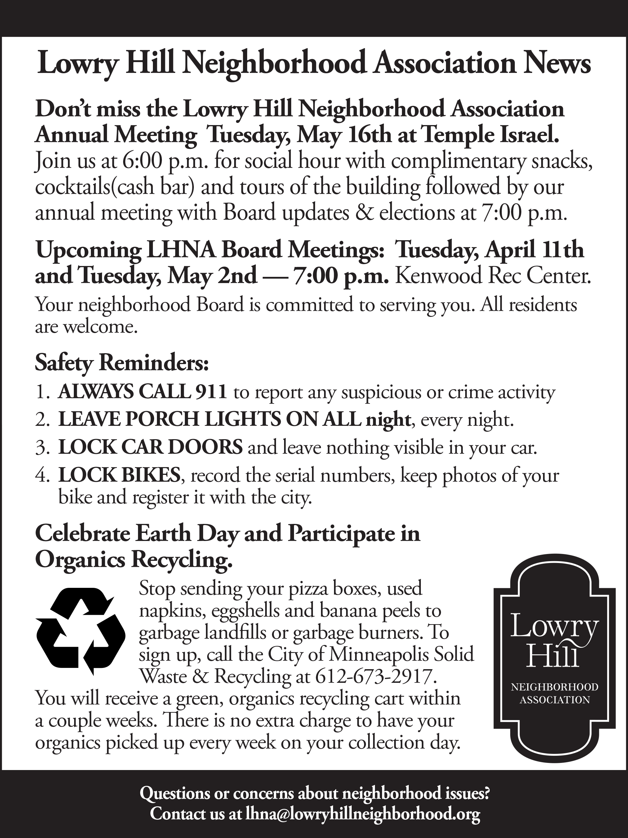
Hill & Lake Press Ads
Notes:
Hill and Lake press ads
we always have an ad to let you know what’s coming up
and to announce events like the Ice Cream social

Slide 64
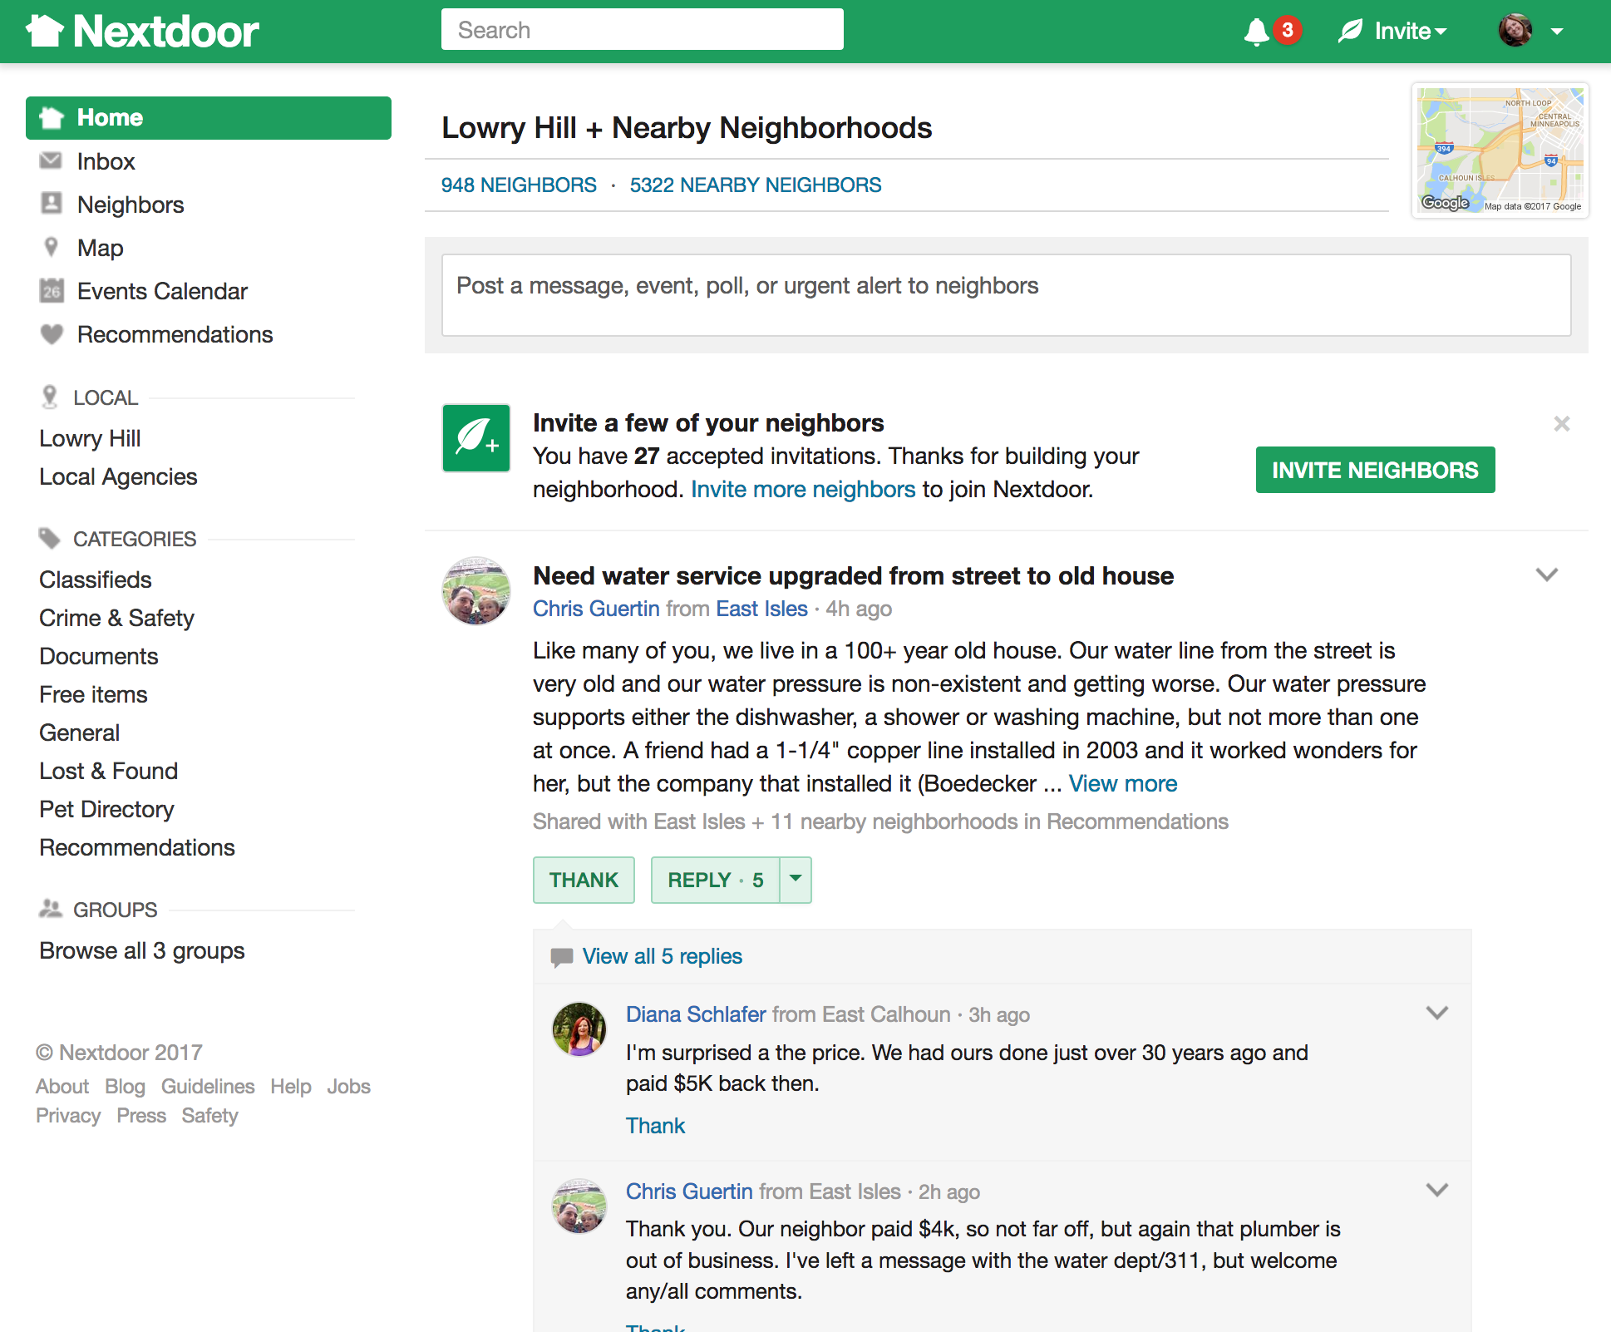
Next
Door website
Notes:
We also post on Next Door,
a free private social network for your neighborhood community.
And now back to our president Phil Hallaway

Slide 65
Election: LHNA Board
Philip Hallaway, President

Slide 66
Current Board
Phil Hallaway, President
Michael Cockson, Vice President
Toni D’Eramo, Treasurer
Emily Beugen, Secretary
Kathleen Bottini
Jennifer Breitinger
Clint Conner
Krishna Dorney
Sam Ellingson
Jimmy Fogel
Bob Hinck
Tom Huppert
Evan Stern
Lee Switzenberg
Craig Wilson

Slide 67
Elections & Terms
Board members serve 2 year terms
Maximum 3 consecutive terms (6 years)
Special thanks to departing members
  Emily Beugen
  Phil Hallaway
  Tom Huppert

Slide 68
Returning board members
Will serve 2nd year of 2 year term
  Michael Cockson Lee Switzenberg
  Clint Conner Craig Wilson
  Sam Ellingson

Slide 69
Proposed Slate for New Term
Board members for re-election
  Kathleen Bottini
  Jennifer Breitinger
  Krishna Dorney
  Toni D’Eramo
  Jimmy Fogel
  Bob Hinck
  Evan Stern
New candidates
  Justin Baylor
  Fran Davis
  Charles Scheiderer

Slide 70

Want to Get Involved?
Talk to a Board member tonight
Email us lhna@lowryhillneighborhood.org
Come to monthly meetings
  1st Tuesdays, September through June
  Kenwood Rec Center, 7PM

Slide 71
LHNA always accepts your tax-deductible contributions
We value and welcome everyone in our community!
Thanks for your interest
Thanks for your participation
Thanks for your continued Financial support
-And-
THANK YOU for your presence here tonight!

Slide 72
Thank You! and please…
Remember to
Leave a
Light On!

